Slide 1
Microdetector Electronics
Grzegorz (Gregory) Deptuch
ASIC Development Group Review
December 12, 2011

Slide 2
Outline
Introduction:
  Mission
  Resources (people, tools, instruments, competences)
ASICs / sensors – major projects and technologies
  Projects accomplished
  Current projects
  Look at the future
Collaborative efforts
  With other government laboratories
  International efforts
  With industrial partners
Infrastructure for ASIC testing and around
Risks and potential deficiencies
Conclusion

Slide 3
Mission
Provide integrated circuits for detectors to run experiments
R&D on detectors for future
Projects usually brought from physicist directly to group or started internally with consultation with knowledgeable in house physicists
Primarily: instrumentation for HEP;
secondarily: where synergies and where appropriate
- leverage technologies for other fields and work through collaborations
ASIC Development Group Part of PPD/EED
3

Slide 4
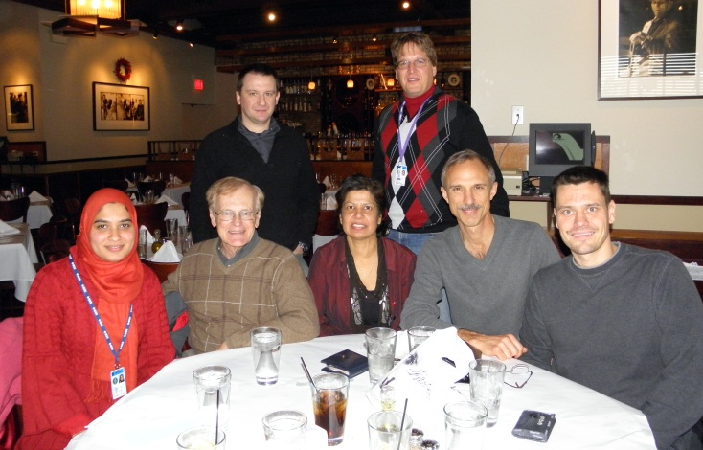
Resources: people
6 ASIC designers (3 PhDs)
  2 senior-leader
  1 pursuing PhD
  1 providing maintenance
  of tools, licenses, scripts, etc.
  (essential!!!)
1 engineering physicist (PhD)
1 test engineer (assigned)
2 technicians
+ depending on needs 1 PCB drafter
+ occasional support from other resources within PPD/EED, CD and other departments at Fermilab
4

Slide 5
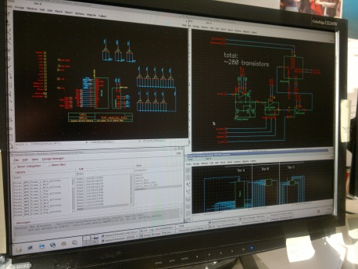
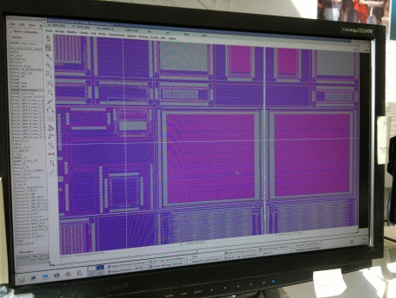
Resources: tools
Cadence – main frame
+ Mentor Graphics – Magma – Silvaco – Tanner
  tools selected from various vendors to best match the needs; guidelines accounting for the choice:
  strictly necessary features and capabilities –
  - co-existence under common frame and cost
  advanced technology nodes are strongly tools linked, full-custom approach becomes inaccessible @ <100nm
  cost is significant, but unavoidable to fulfill needs, stay competitive and innovative
  heterogeneity of tools and integration under one roof contribute to operation costs
Recent
moves:
Savings due to shifting from owning Cadence licenses to renting
Shifting underway from Cadence IC5.1X to IC6.1X
Migration from Eldo (Mentor Graphics) to Analog-Mixed-Mode Simulation environment (AMS) with Spectre (Cadence)
Optimization of access to XL and GXL (Virtuoso) features through license tokens in Cadence IC6.1X

Slide 6
Custom IC Design Flow
Design Specifications
Analog
Digital
Schematic Capture
Simulation:Mixed Mode,Digital,Analog
Verilog/VHDL
Layout
Place & Route
Synthesis (don’t have)
Place & Route Timing Driven (don’t have)
DRC/LVS physical verification:
Design Rule Check /
Layout vs. Schematic
Bench (laboratory tests)
Parasitic Extraction
Post – Layout Simulation
Fabrication
Production (automated tests)
Tapeout

Slide 7
SoftwareTools
Cadence
Mentor
Magma
Tanner
Silvaco
schematic VSE XL
Layout Editor (Viewer and basic P&R)
Process & device level simulation
Simulation: Spectre,
NC Verilog
& mix mode AMS
under ADE XL and hierarchy editor
Simulation: Eldo & mix mode
Simulation: Finesim/Finesim Pro (Fast analog simulation of big design mixed mode included
number of seats of basic tools = number of group members
more sophisticated features use up more tokens thus limits number of people able to work simultaneously
single licenses for physical verification
no RTL synthesis, timing and constraints driven implementation etc.
Layout VLS GXL
Not timing driven P&R
DRC/LVS Assura
hierarchical ver.
DRC/LVS Calibre
flat verification
(industry sign off)
DRC Quartz
hierarchical ver. Compatible with Calibre rules
Parasitic Extraction: Assura QRC + backannotation

Slide 8
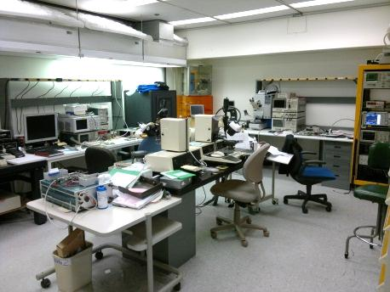
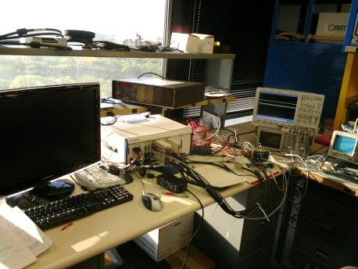
Resources: instruments
ASIC test lab spaces
+ “clean room” (probe stations /one for 8”/ and measurement instruments)
+ 2 labs (FlexRIO National Instruments systems and ordinary test equipment + radioactive sources)
+ robotic chip testing station (under upgrade)
+ manual bonding station
+ PCB components mounting lab
ASIC test lab
Requisition of two PXI/PXIe FlexRIO National Instruments digital and analog (ADC,LVDS,CMOS,DAC,DMM,power, etc.) systems based on LabView – fulfilling hardware needs for testing of chips
DC-3GHz spectrum analyzer – intended for noise measurement bench – crucial but needs development!
Other instruments: static parameter / LCR / Logic / network analyzers/ V / I source, pA, digital oscilloscopes, etc.
bench NI test setup
Recent
moves:
comment:
Instruments age technologically; some are not up to current measurement standard and procedures – needs addressing

Slide 9
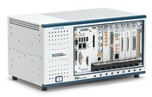
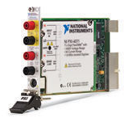
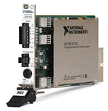
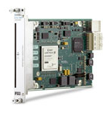
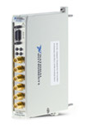
Hardware > National Instruments
  NI PXIe-1078 9-Slot 3U Chassis
  NI PXIe-1075 18-Slot 3U Chassis
  NI PXIe-8133 1.73 GHz Quad-Core Controller
  NI PXIe-8108 2.53 GHz Dual-Core Controller
  NI PXI-4110 Triple-Output Programmable DC Pwr Supply (qty-4)
  NI PXI-4071 7½-Digit PXI Digital Multimeter (DMM) and 1000 V Digitizer (qty-2)
  NI PXI-6704 Static Analog Output -- 16-Bit
  NI PXIe-4141 4-Channel Precision SMU With NI SourceAdapt Technology
  NI PXIe-7962R NI FlexRIO FPGA Module for PXI Express (qty-6)
  NI 6581 Digital Adapter Module for NI FlexRIO (qty-2)
  NI 6585 200 MHz LVDS Digital Adapter Module for NI FlexRIO (qty-2)
  NI 5761 14-Bit ADC, 250 MS/s Adapter Module for NI FlexRIO (qty-2)
Major acquisition in 2011 – contribution of US-Japan collaboration funds (~$42k) for development of SOI monolithic pixel detectors

Slide 10
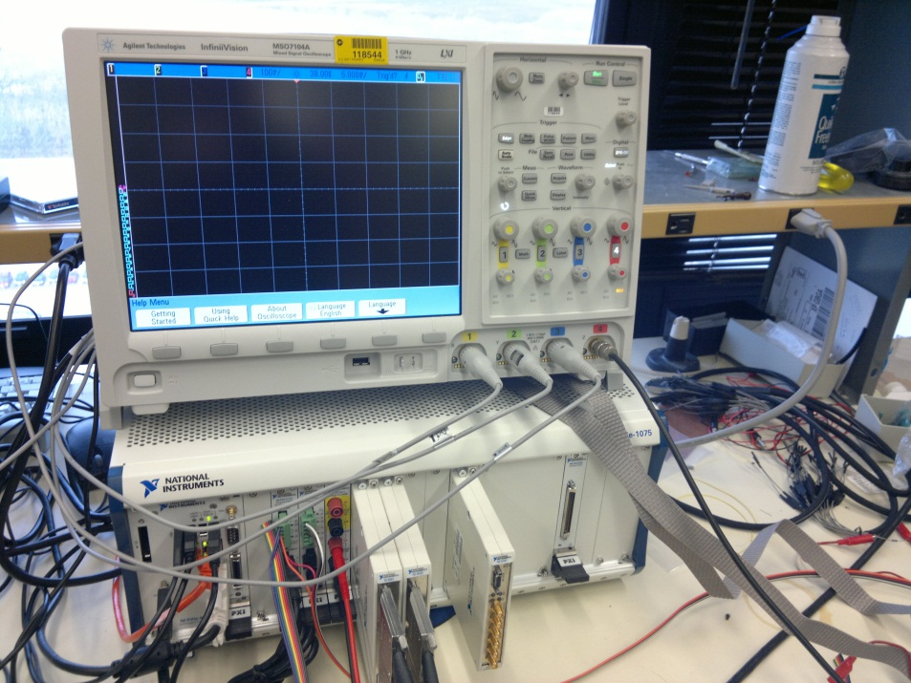
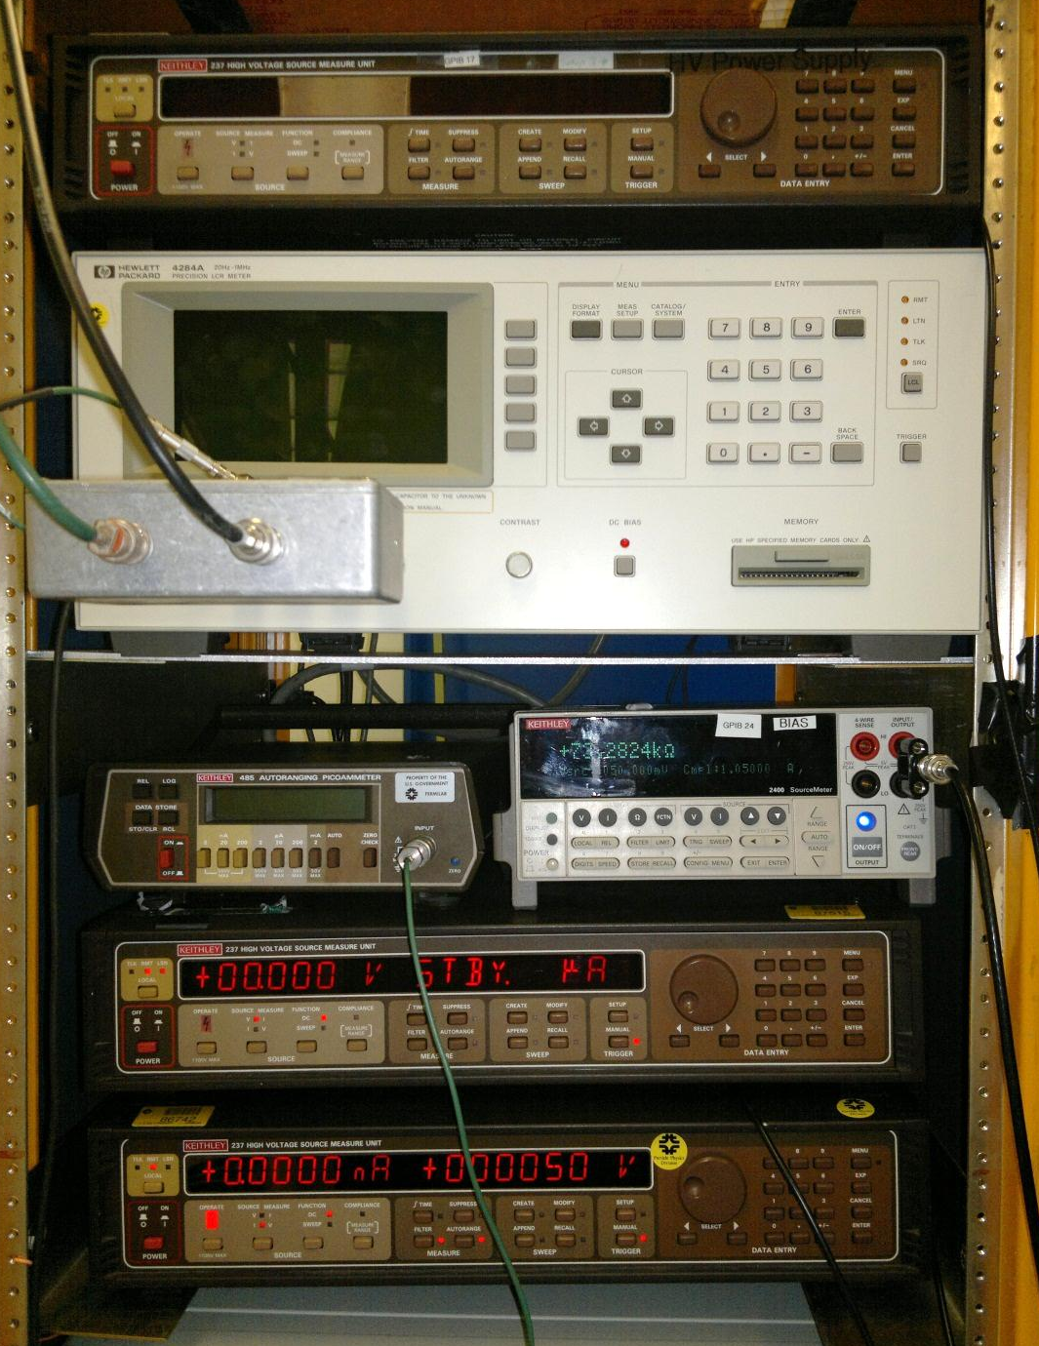
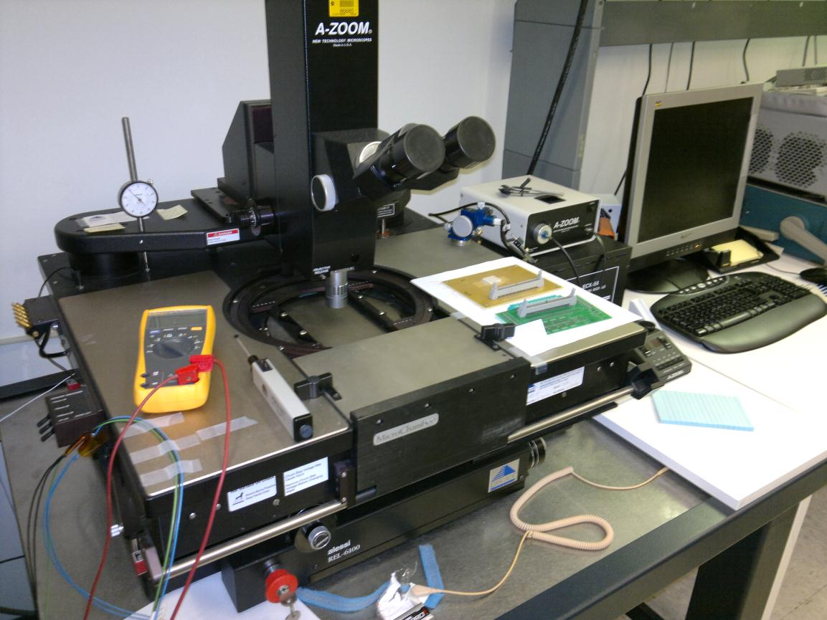
Resources: instr. hardware
2 NI analog/digital (up to 200MHz CMOS and LVDS
4 ch. 150MHz ADC) chip test benches
HP4284A (LCR meter) – external DC bias
using K237, K485 pAmmeter
Keithley 237s (V/I sources, and V/I meters
2 probe stations – with home-made dark boxes

Slide 11
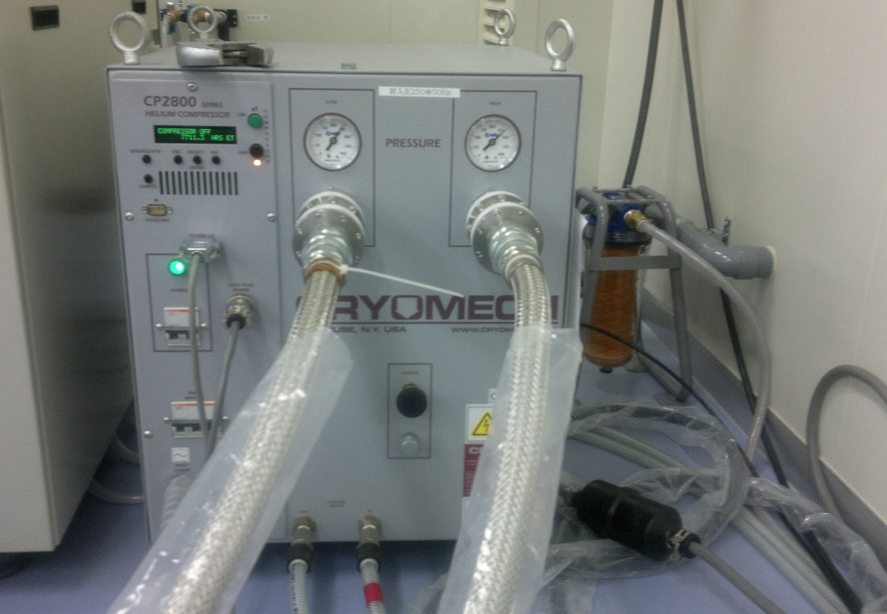
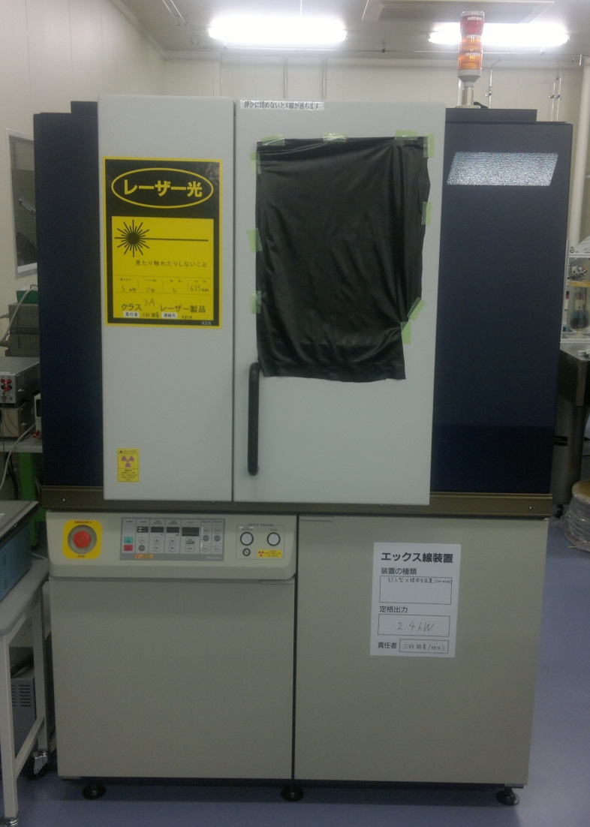
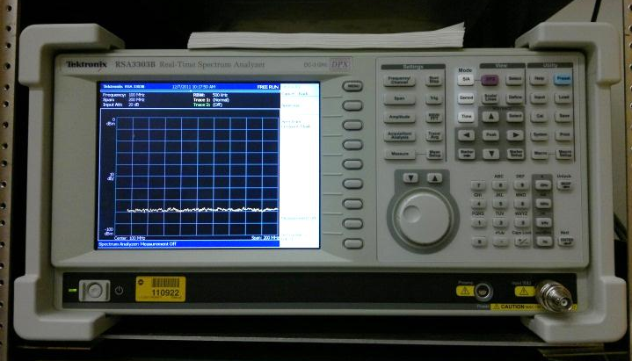
Resources: instr. hardware to acquire / build
Extension + modernization of instrumentation is needed to handle new tasks
Closed circuit liquid He Cryo-cooling system;
controlled T=T=RT1 70K
picture courtesy of Advanced Instrumentation LaboratoryKEK
X-ray irradiation (up to 1Grad) with on-wafer
irradiation capability and detector testing with X-rays
picture courtesy of Advanced Instrumentation LaboratoryKEK
Transistor noise measurement bench
to develop low-noise amplifier boards

Slide 12
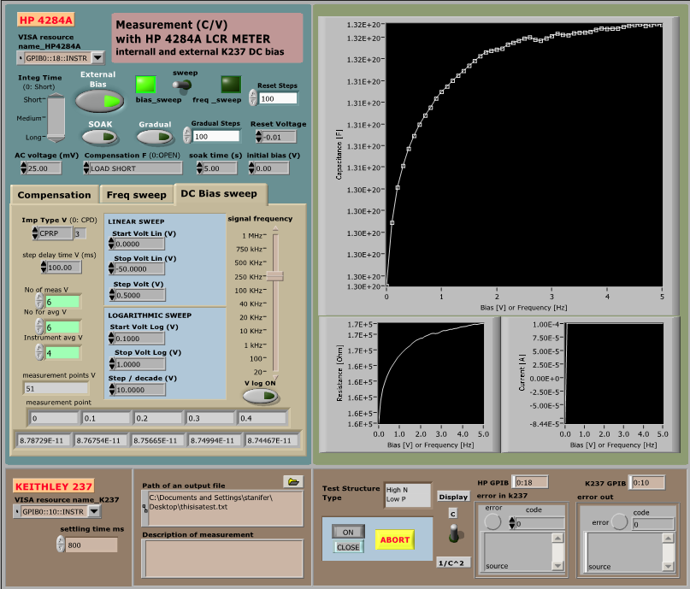
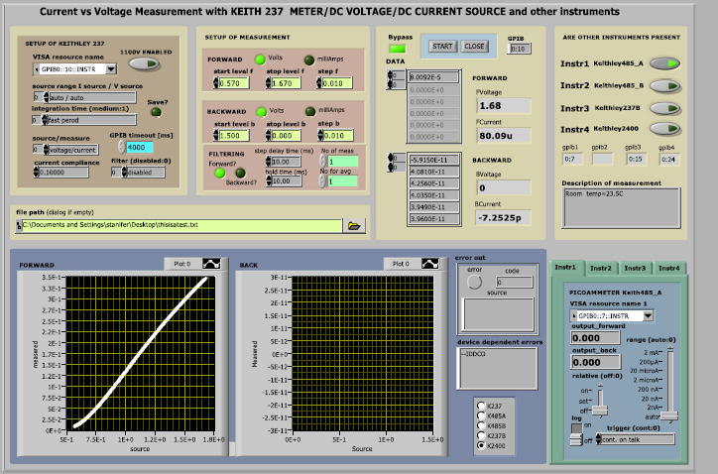
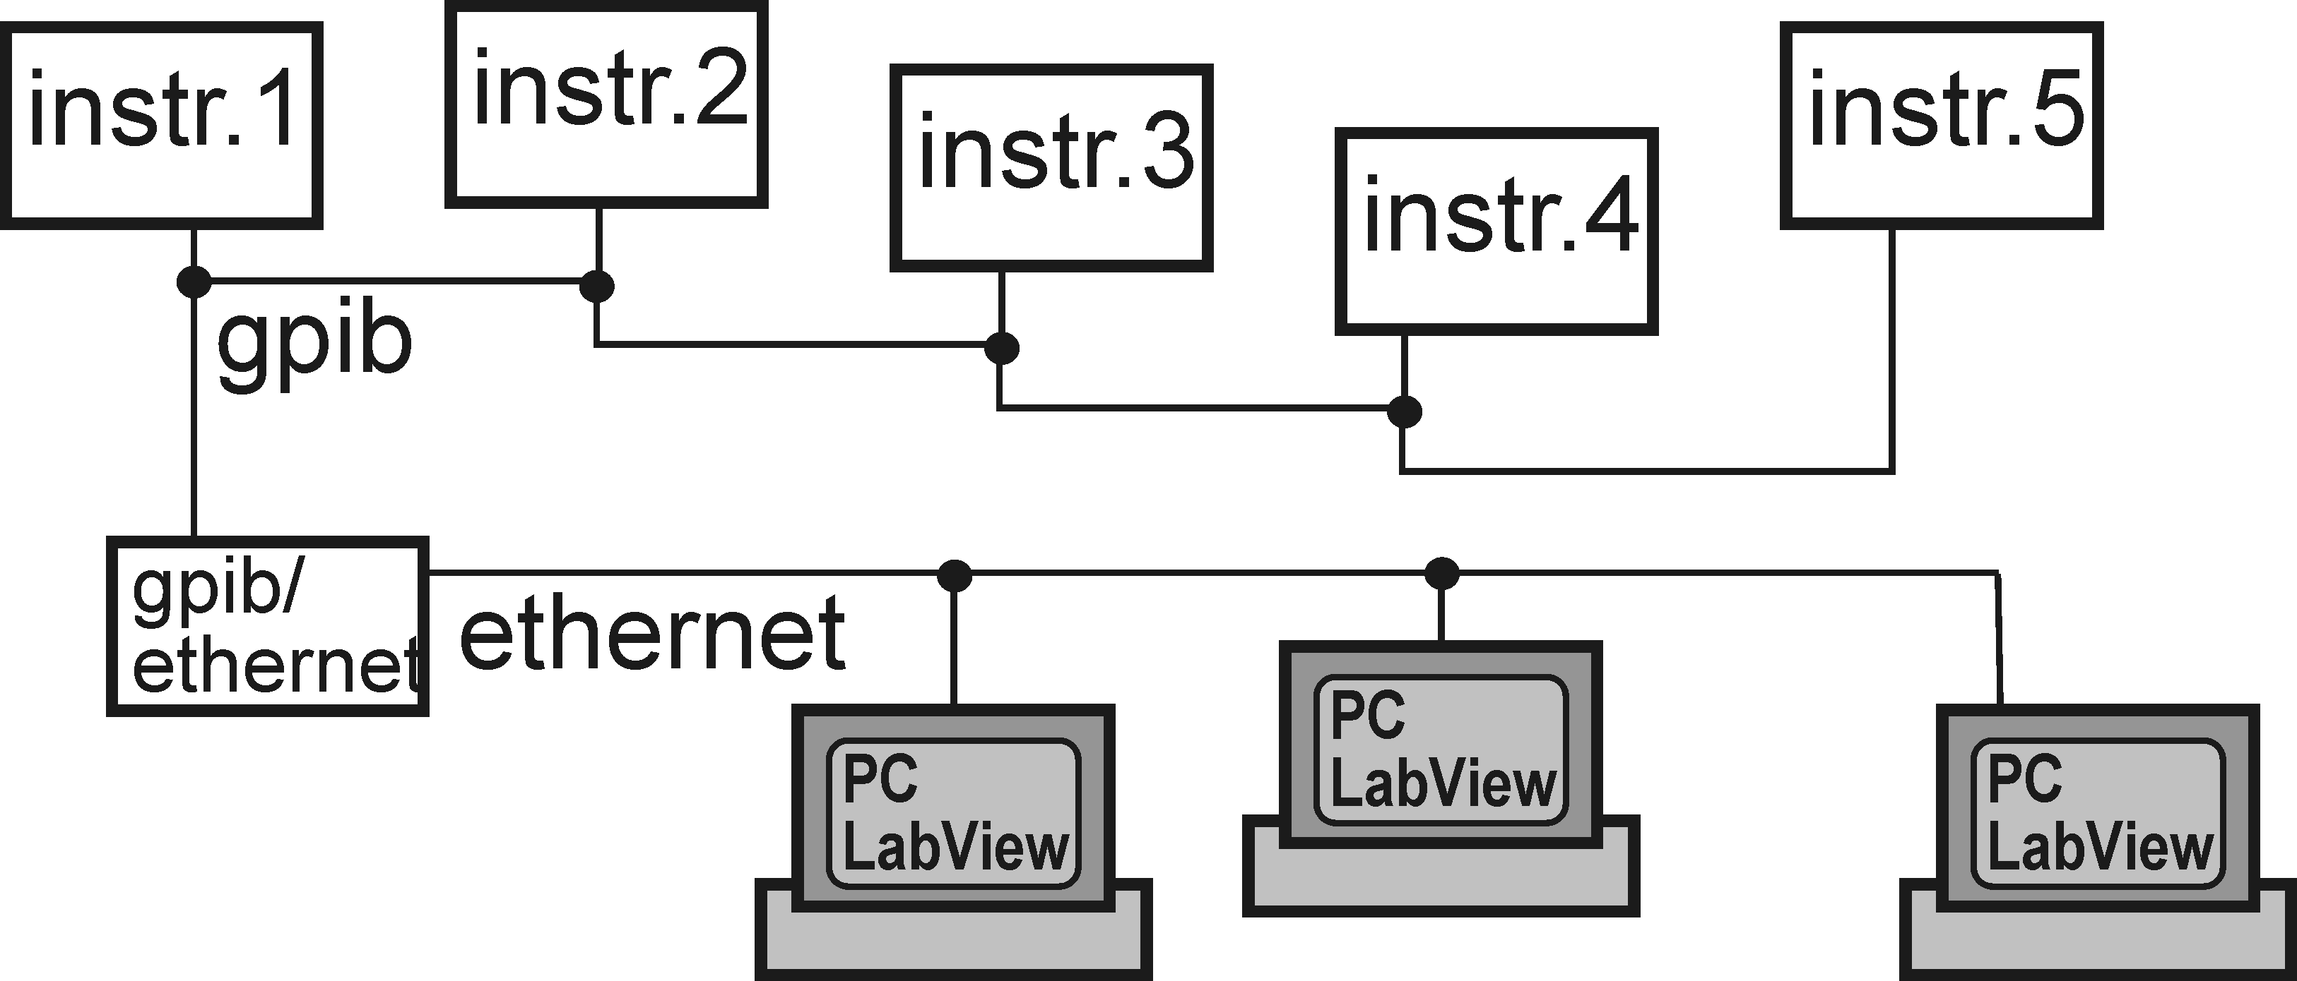
Resources: instr. software
1) tests of devices
2) tests of chips and systems
HV C/V
multi-instrument I/V
Complete LabView based applications developed
within the ASIC Group with participation of students
for typical semiconductor device measurements:
C/V, I/V, parameter extraction, HCE degradation, etc.
Users’ facility developed!
welcome users!

Slide 13
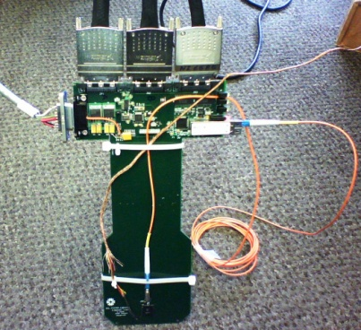
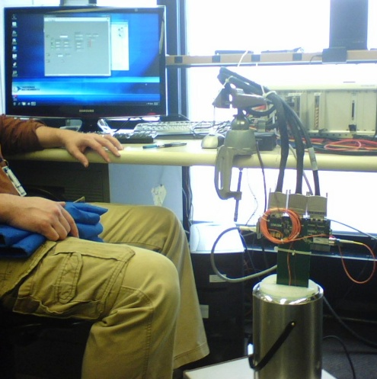
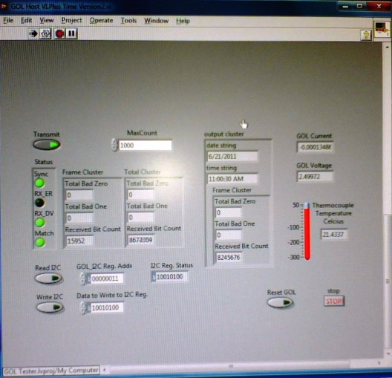
1) tests of devices
2) tests of chips and systems
Accomplished with NI system ex.: GOL LN2
(CERN Gigabit Optical Link – lAr TPC for LBNE)
TEST – determine whether will operate at LN2 temp.
Test board fabricated for submerging GOL in LN2 dewar
Test board is interfacing GOL to Labview NI test stand.
NI Labview software was produced to:
  generate a test pattern that is sent to GOL
  monitor the resulting optical data that is returned from GOL.
TEST1 > transmission of data stopped at -90C > laser diode operation failed but I²C communication worked with GOL submerged in LN2
TEST2 > changed
  laser diode to Fabry-Perot (FP) laser (Finisar FP-1310-4I-LCA)
  fiber receiver to 1310nm device
  adjusted bias current to 21mA
  tested GOL in LN2 - “works”
0 bit errors in 6e+12 bit transfers with GOL temp. going from 20 C to LN2 and back to 20 C, over a 2 hour period, submerged for 40 minutes
Proof of NI concept of testing: short time to develop and focus on actual problems!

Slide 14
NI Labview test of ASIC – “drift imager in SOI” in temp. controlled box. It will allow for the I/V characterization and verification down to the picoamp and microvolt level. Stimulation with both digital and analog signals
Example of setup
under construction

Slide 15
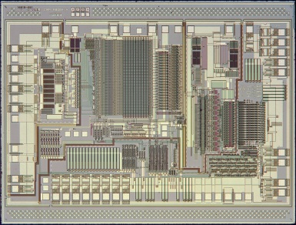
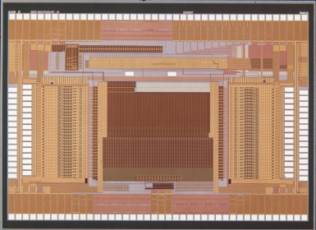
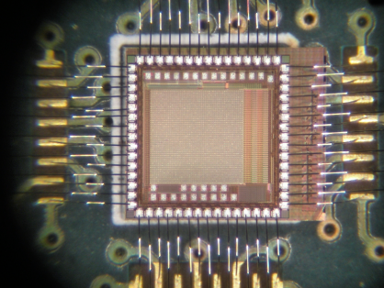
ASIC: major projects:
Electronics and sensor technology is central to Particle Physics research – leads to spinoffs in domains using similar detection technique (ex. nuclear medicine)
Technology is moving rapidly – science is a niche market – leverage of technologies for advancing instruments of capabilities which have so far not even dreamed of
Sensor arrays of unprecedented sizes and in-situ processing
- ANL/ATLAS and FNAL/CMS QIE
- CMS pixels upgrade, CMS tracker-trigger
- photon science instr. (X-ray Photon Correlation Spectroscopy - BNL)
- LHC in hardware tracker (content addressable/associative memories)
- monolithic pixel detectors in SOI process
- cold electronics: lAr TPC for LBNE (and CDMS ?)
- solid state PM G-APD, SiPM (implementation in 3D-IC)
- highly granular pixels for lepton collider
and some more (e.g. sensors, qualification)
Broad activity in the 3D-IC context linking several items from above
QIE9
DCAL
VIP2a 3D-IC
15

Slide 16
There are many opportunities of projects for HEP, we need to take care to use resources wisely
Prospects of cooperation beyond HEP (different timescales) - resources must be managed even more carefully
Knowledge and experience gained on these smaller projects provides expanded professional development and new insights for future HEP
research, having apparently general nature, may result in a technology that may prove indispensable for the HEP program, such as monolithic detectors best suited May Be for the CMS pixel upgrade!
example of collaboration offer from
Advanced Intrsumentation Laboratory (KEK)

Slide 17
ASICs/sensors projects and technologies
Technologies:
2005
2010
2015
2020
AMS 0.35 BiCMOS/SiGe
Some new technology options may appear: JAZZ/ASI, Honeywell SOI, IBM SiGe, etc.
TSMC 0.25 CMOS
MIT-LL .18/.15
FD SOI CMOS
OKI .2/.15 FD SOI CMOS
???
GF .13 CMOS 3D-IC
GF 65nm CMOS 3D-IC
Roadmap based on current understanding of needs of various projects
TSMC/IBM/UMC/GF 0.13 CMOS
???
TSMC/IBM/UMC/GF 65nm CMOS
17

Slide 18
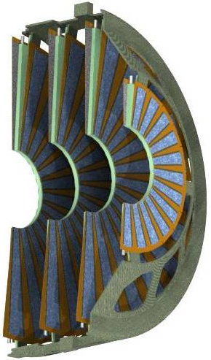
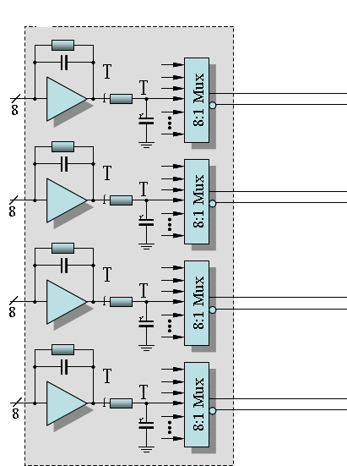
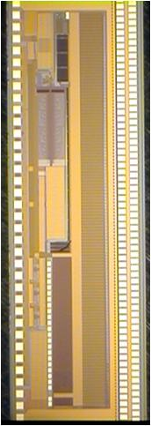
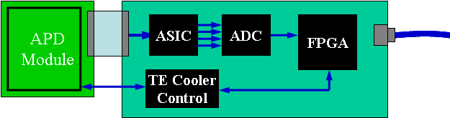
Recently completed projects
FPHX for Phenix at RHIC with LANL and BNL (completed 2009)
Front End Electronics for the NOvA Neutrino Detector (completed 2010)
HDI
Sensor
HDI
8:1 Muxes run @ 16 MHz to sample each channel at 500
2 Msps per channel
Adjustable risetime & fall-time
Mini-strips are oriented to approximate an arc
Signal holes
Gain at shaper:
500 mV/fC
3-bit ADC
τ_{p}: 60 ns
ENC: 150e + 140e/pF
Power_{MAX}: 110 μW/ch
Ileak_{MAX}: 100nA/strip
completed
FPHX Chips (13 per column)
DAQ
completed
128 channels
output data push

Slide 19
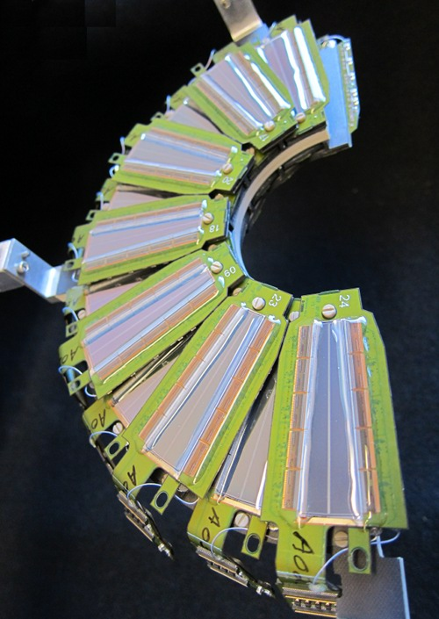
close collaboration with:
physicists from Fermilab and other laboratories from the US and abroad BNL, LBNL, ANL, LANL, MIT-LL, SANDIA, CERN, KEK, and UPenn, CornellU, GT, SMU ... + numerous laboratories and universities and with detector and electronics development teams
PHENIX @ RHIC
19

Slide 20
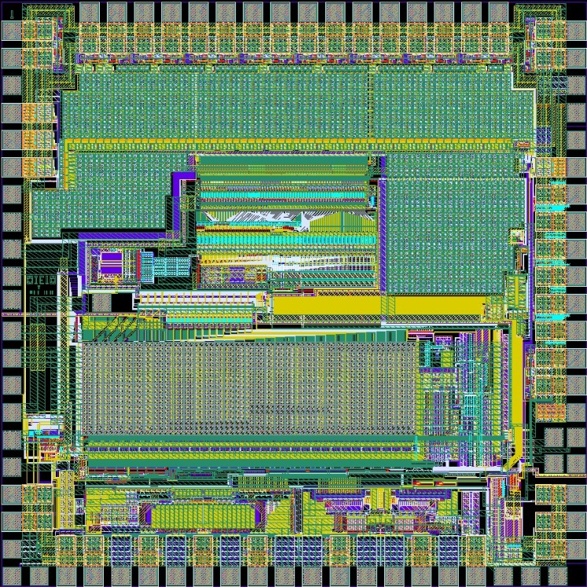
ASIC: current projects:
QIE
QIE chips designed at Fermilab for HEP:
QIE5: KTEV (2u ORBIT CMOS) - QIE6: CDF (2u ORBIT)
QIE7: MINOS (2u ORBIT)
QIE8: CMS (0.8u AMS BiCMOS)
QIE9: BTEV (0.8u AMS BiCMOS)
QIE10: a new chip for CMS & ATLAS (0.35u AMS SiGe BiCMOS process)
Currently used by CMS
QIE10 successor of QIE8:
QIE8: 0 – 30 pC range, with 2.7 fC/LSB
at the low end (13.5-bit dynamic range)
Resolution = 2%
QIE10: 0 – 330 pC range (10x higher!),
with 3 fC/LSB at the low end
(nearly 17-bit dynamic range).
Resolution = 1.4%
QIE10 (first full-chip prototype)
submitted 11/7/2011
- 16 bits out every 25 ns (6-bit mantissa, 2-bit exponent, 2-bit CapID, 6-bit timing discriminator ADC)
- 4 LVDS outputs running at 160 MHz clock
- Timing discr. analog out and 6-bit digital (σ_{t}=~1ns)
- Source monitor calibration circuit
Will continue until finished

Slide 21
ASIC: challenges - R&D projects
Lepton Collider Vertex Detector - precision
  superb IP σ_{sp}=(5µm ⊕ 10µm/(p sin^{3/2}θ))
  transparency ( ~0.1% X₀ per layer )
Muon Collider – processing to deal with harsh background environments
  1-3 TeV muon collider on FNAL site
  Substantial huge detector and radiation backgrounds
  fast timing and high precision for background rejection
CLIC – speed and precision
  a few ns σ_{t}
SLHC (HL LHC) – large scale, high speed, harsh environment
  200-400 int/25 ns crossing, participation of tracker in trigger required
  large scale systems, heat evacuation
  on-detector background rejection and radiation backgrounds
X-Ray – speed – density – large area seamless – single γ & 5 mag. orders
  variety of goals – timing – count rate – granularity and energy resolution
Intensity frontier
  thin, fast electronics - extreme cold conditions of operation

Slide 22
Future brings new challenges – research in electronics/detector technologies is building a toolbox to deal with these challenges
3D-IC:
started as a means of reducing mass for ILC pixel VxD – evolved from SLD CCD
first design was in FD SOI at MIT (the first chip to satisfy and even exceed some of the basic functional requirements)
other labs have adopted this initial token propagation sparsification scheme and continue to pursue it for ILC and B factory applications (e.g. Univ. Bergamo, Italy)
limitations of FD SOI for analog led to work on 3D-IC using commercial bulk CMOS with Tezzaron
ILC was first but Fermilab physicists suggested several other applications and some other were brought thanks to links of the ASIC group with other labs
at the request of Young Kee, the ASIC group began to work with KEK and under a Japan-US agreement (MoU 2007) on monolithic SOI devices. This led to joint patent application for process optimization
New detector ideas and imaging devices are advancing.
Mono-
lithic
in SOI:

Slide 23
Why work on 3D-IC is so appealing?
Why?
Current fine-grained detector technologies face serious limitations; incremental improvements have proved inadequate
3D integration offers a transformational change to address current roadblocks to advance detectors in these areas
3D-IC definition:
A chip in three-dimensional integrated circuit (3D-IC) technology is composed
of two or more layers of active electronic components,
integrated both vertically and horizontally
3D-IC (revolution) technologies:
Through Silicon Vias (TSV) for vertical wafer/chip connectivity not only electronic chips but also for attaching detectors to readouts
Bonding: Oxide, polymer, metal, or adhesive strengthened (W-W, C-W, C-C)
Wafer thinning: agressive and precise
Back-side metallization and patterning
3D-IC is part of the toolbox to deal with challenges

Slide 24
Does 3D-IC define tracking sensors and electronics for future experiments?
3D-IC is the enabling technology for a integrated tracking trigger for the CMS @ HL-LHC (crucial role of providing local hits from top and bottom tiers)
g-2 requires low mass, high accuracy tracking for electron projection to the beamline – 3D-IC derived device thinning
K->π⁰νν requires high accuracy gamma conversion, track pointing and <1ns timing. Pixelated SOI or 3D-IC can provide this.
Future lepton colliders will need low mass, high resolution vertex detectors + HL experiments will pose problems in resolving tracks 3D-IC enables associate memories with >10x the capabilities of current generations (ATLAS FTK)
The Muon Collider vertex and tracker will need σ_{t}=~1ns and will likely need large areas of tracking and imaging calorimetry with σ_{t}<1ns, where 3D-IC or SOI - style integration of electronics and sensors is likely to be crucial
Photodetectors for many experiments need to provide fast time stamping, short recovery time, and excellent position information making a 3D integrated digital SiPM to be the optimal choice (low power tracking detector)
Generally, large area, totally active detector arrays will be key in future vertex detectors è active edge sensor and 3D-IC lead to these capabilities
24

Slide 25
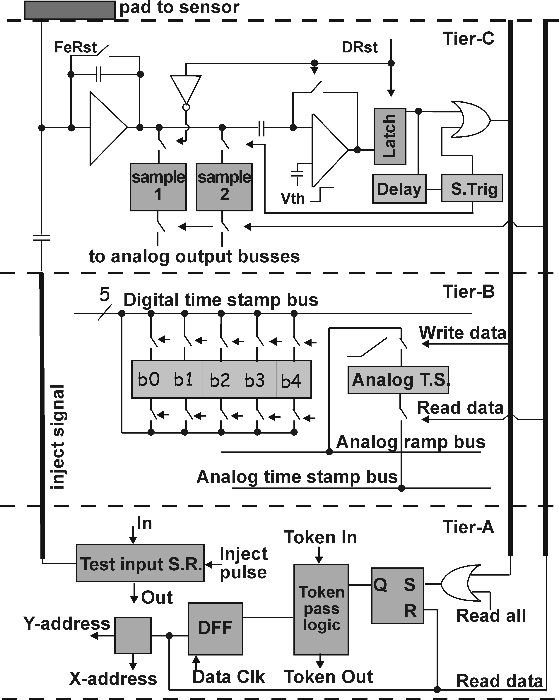
First steps with 3D-IC
Particular set of challenges of the ILC's vertex detector led to complex circuitry
3D enables more local processing in a pixel of a given size without going to smaller more expensive feature size processes
Fitting required number of transistors achievable only with 3D-IC
TSV
TSV
ILC VXD must:
TSV
provide spatial resolution of single point
particle impact better than σ=5 μm
deal with congested hit patterns
252 hits/beam train/mm²
pixel ~20×20 μm², 50-100 μm/layer
spatial resolution improved by
interpolation
data driven, fast, sparsified readout
groups of BXs timed
3tier pixel scheme of VIP for ILC
25

Slide 26
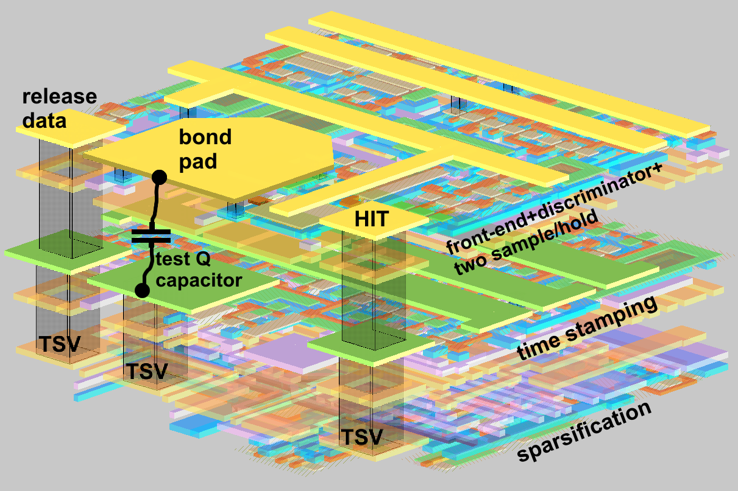
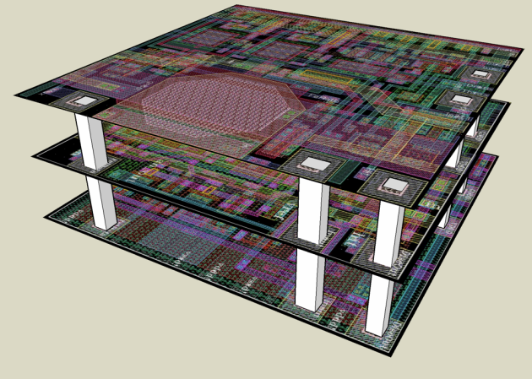
Illustration of 3D-IC in the example of VIP1
No Sensor! separate process
integrator, correlated double
sampler, w/ two S&H cells,
auto-zeroed discriminator
and timing circuitry for
generation of the “hit” pulse
22μm
Analog & Digital time stampers
analog S&H latching analog
ramp voltage and 5 bit
(7 for VIP2) SRAM latching
Gray coded timing from
global counter
token passing logic for readout
only those pixels that store hit,
token arriving to pixel activates
X-Y kines for address generation,
and races to the next hit pixel, while
Readout of data continues
VIP1 pixel design in micromagic
http://www.micromagic.com/
VIP2

Slide 27
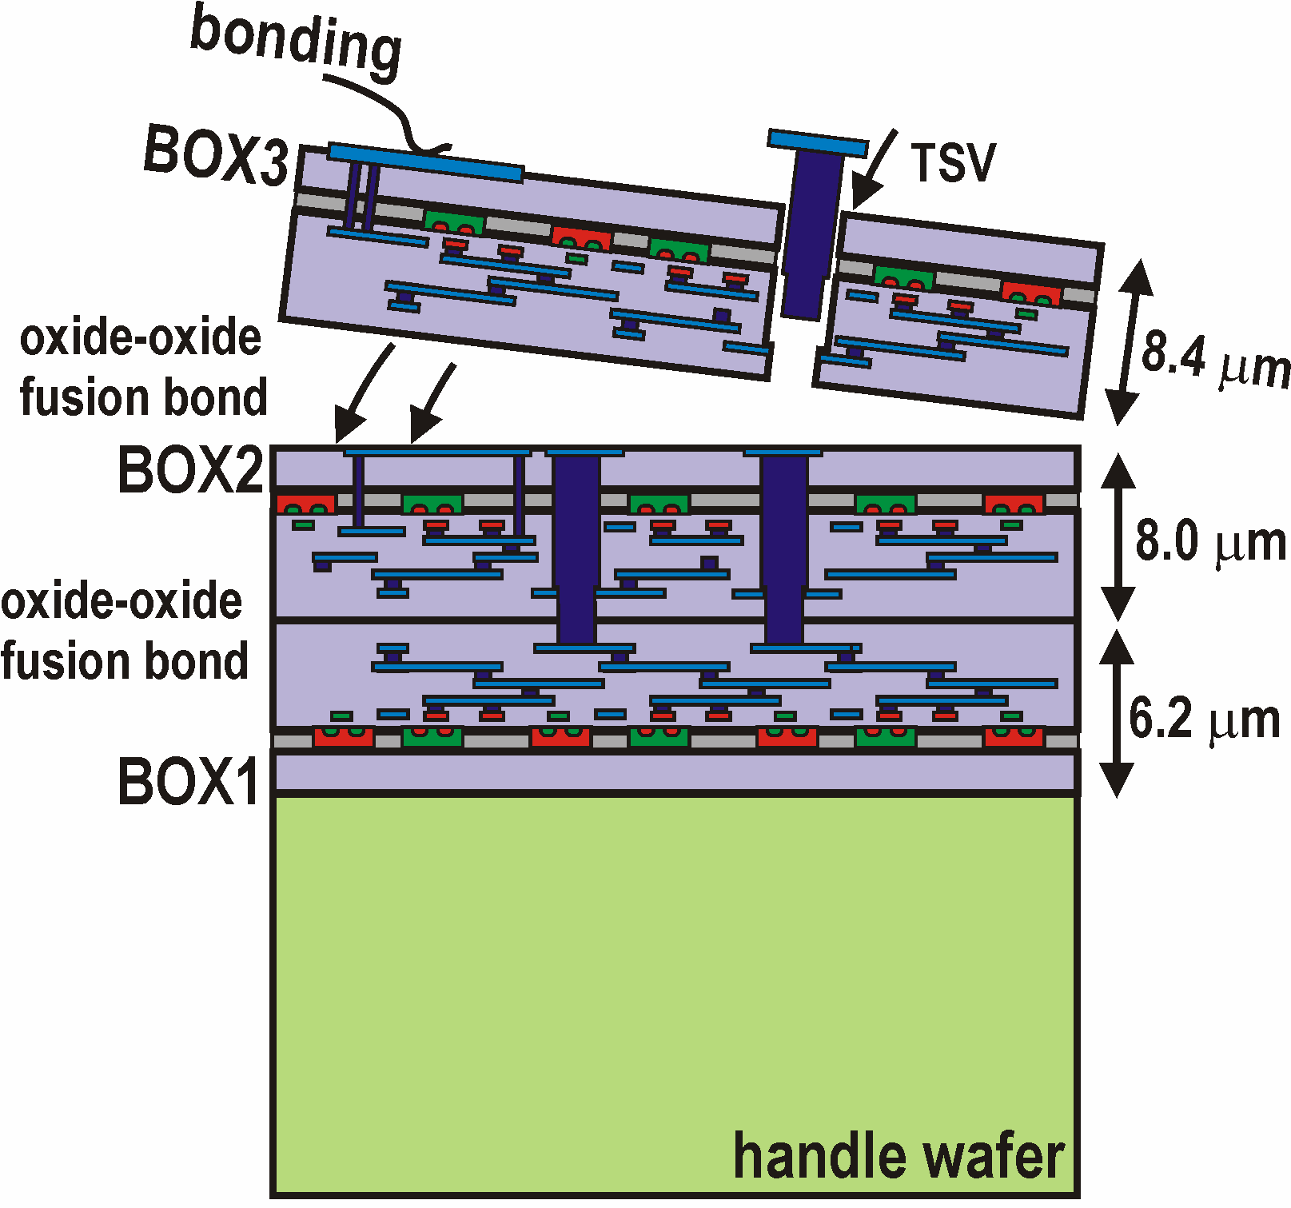
Fermilab was invited to
first 3D-IC process
offered by MIT-LL (DARPA)
2 times (no cost)
3DM2 and 3DM3 MPWs
(0.18 / 015 μm FDSOI 3 tiers)
Back-Face
Convenient use of SOI
for bonding technology
but misfortunate for circuitry
due to charge trapping in
ubiquitous oxides!
First wafer
Face-Face
Through Silicon Vias added to wafers after bonding and thinning)
Vias take space, excluding large area for local interconnect in TSV locations
Presence of natural oxides acts as etch stoppers and bonding surfaces
Potential use of heterogeneous wafers
Via Last
(after wafer bonding)
MIT-LL
3D-IC process

Slide 28
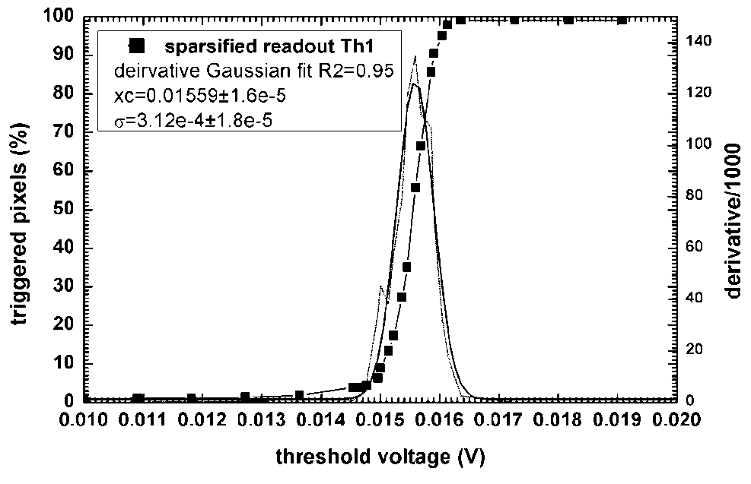
VIP1/VIP2
Prototypes were extensively tested and proof of principle was delivered
Actual functionality was demonstrated (VIP1 had very low yield, VIP2 redesigned to address major issues – close communication with MIT-LL experts – and some high quality results were obtained)
No major issues with V-stacking
No continuation at MIT-LL
Difficulties with analog in FD SOI
run 3DM2
submission Oct. 2006 -> delivery Nov. 2007
run 3DM3
submission Oct. 2008 -> delivery Aug. 2010
in-pixel auto-zeroed discriminator threshold
offsets (best performance even comparing to
anticipated results from 2D process),
no DACs
for correction
Pixel-pixel discriminator threshold dispersions 300μV
look ahead token passing sparsification scheme

Slide 29
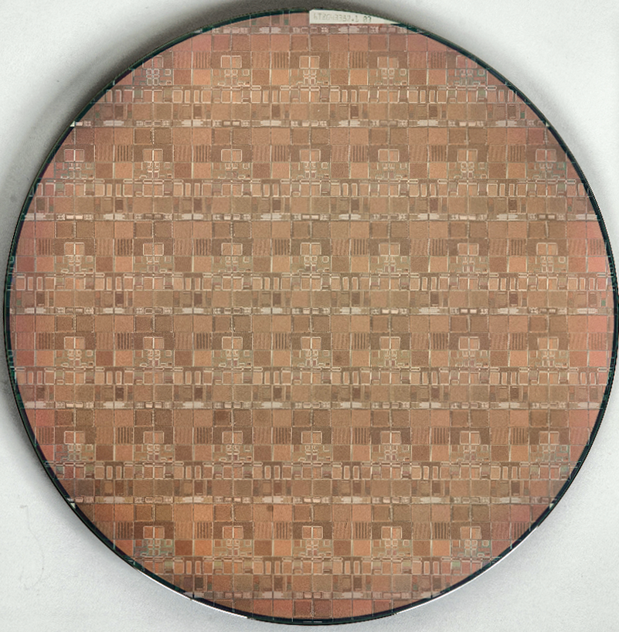
Gaining momentum in 3D-IC work, steps through commercial access to 3D process
Initially small efforts, started at Fermilab, aroused great interest among the detector community worldwide and eventually materialized in the 3D-IC consortium formed and led by Fermilab
Consortium established in late 2008, now 17 members; 6 countries (USA, Italy, France, Germany, Poland, Canada) with Tezzaron (IL)
Unprecedented endeavor – Fermilab acted as silicon broker organizing first 3D-IC MPW run for HEP community
Initial designs for completed in 05/2009; Chartered (GF) 0.130 μm CMOS
All designs passed through Fermilab
  Many challenges in working with cutting edge technology to name some: design mistakes, software tools at Tezzaron (not Cadence), shifting Chartered (GF) requirement, etc.
MPW frame accepted by Chartered in 03/2010
Fermilab run in fab in parallel with 2 other runs (DARPA and SNL – they were successful)
  Some combination of bad luck and human carelessness: first lot of wafer fabricated with reticle shift to optimize yield of chips from a wafer but inhibiting 3D bonding, 3D bonding not successful on first 6 pairs
  Root cause of lack of success of bonding seems to be understood
Tezzaron wafer for 3D chips from Fermilab MPW run
Bonding Singapore è SVTC, TX, è
EVG Tempe, Az, è EVG Austria (proper
chuck + forming gas available in Austria)
Back-side processing moved to Ziptronix,
NC – questionable quality –probably
due to not good 3D bonding in the first place

Slide 30
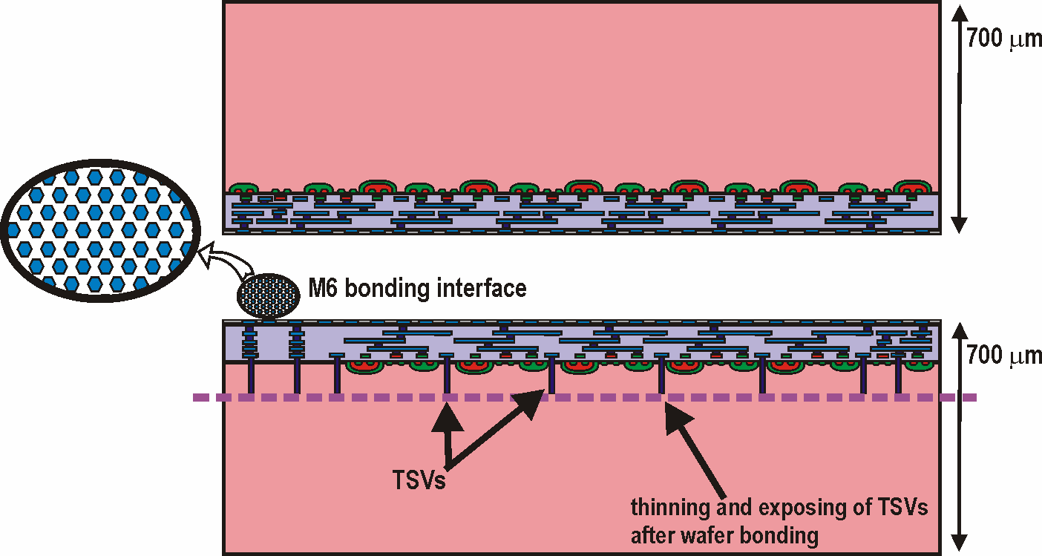
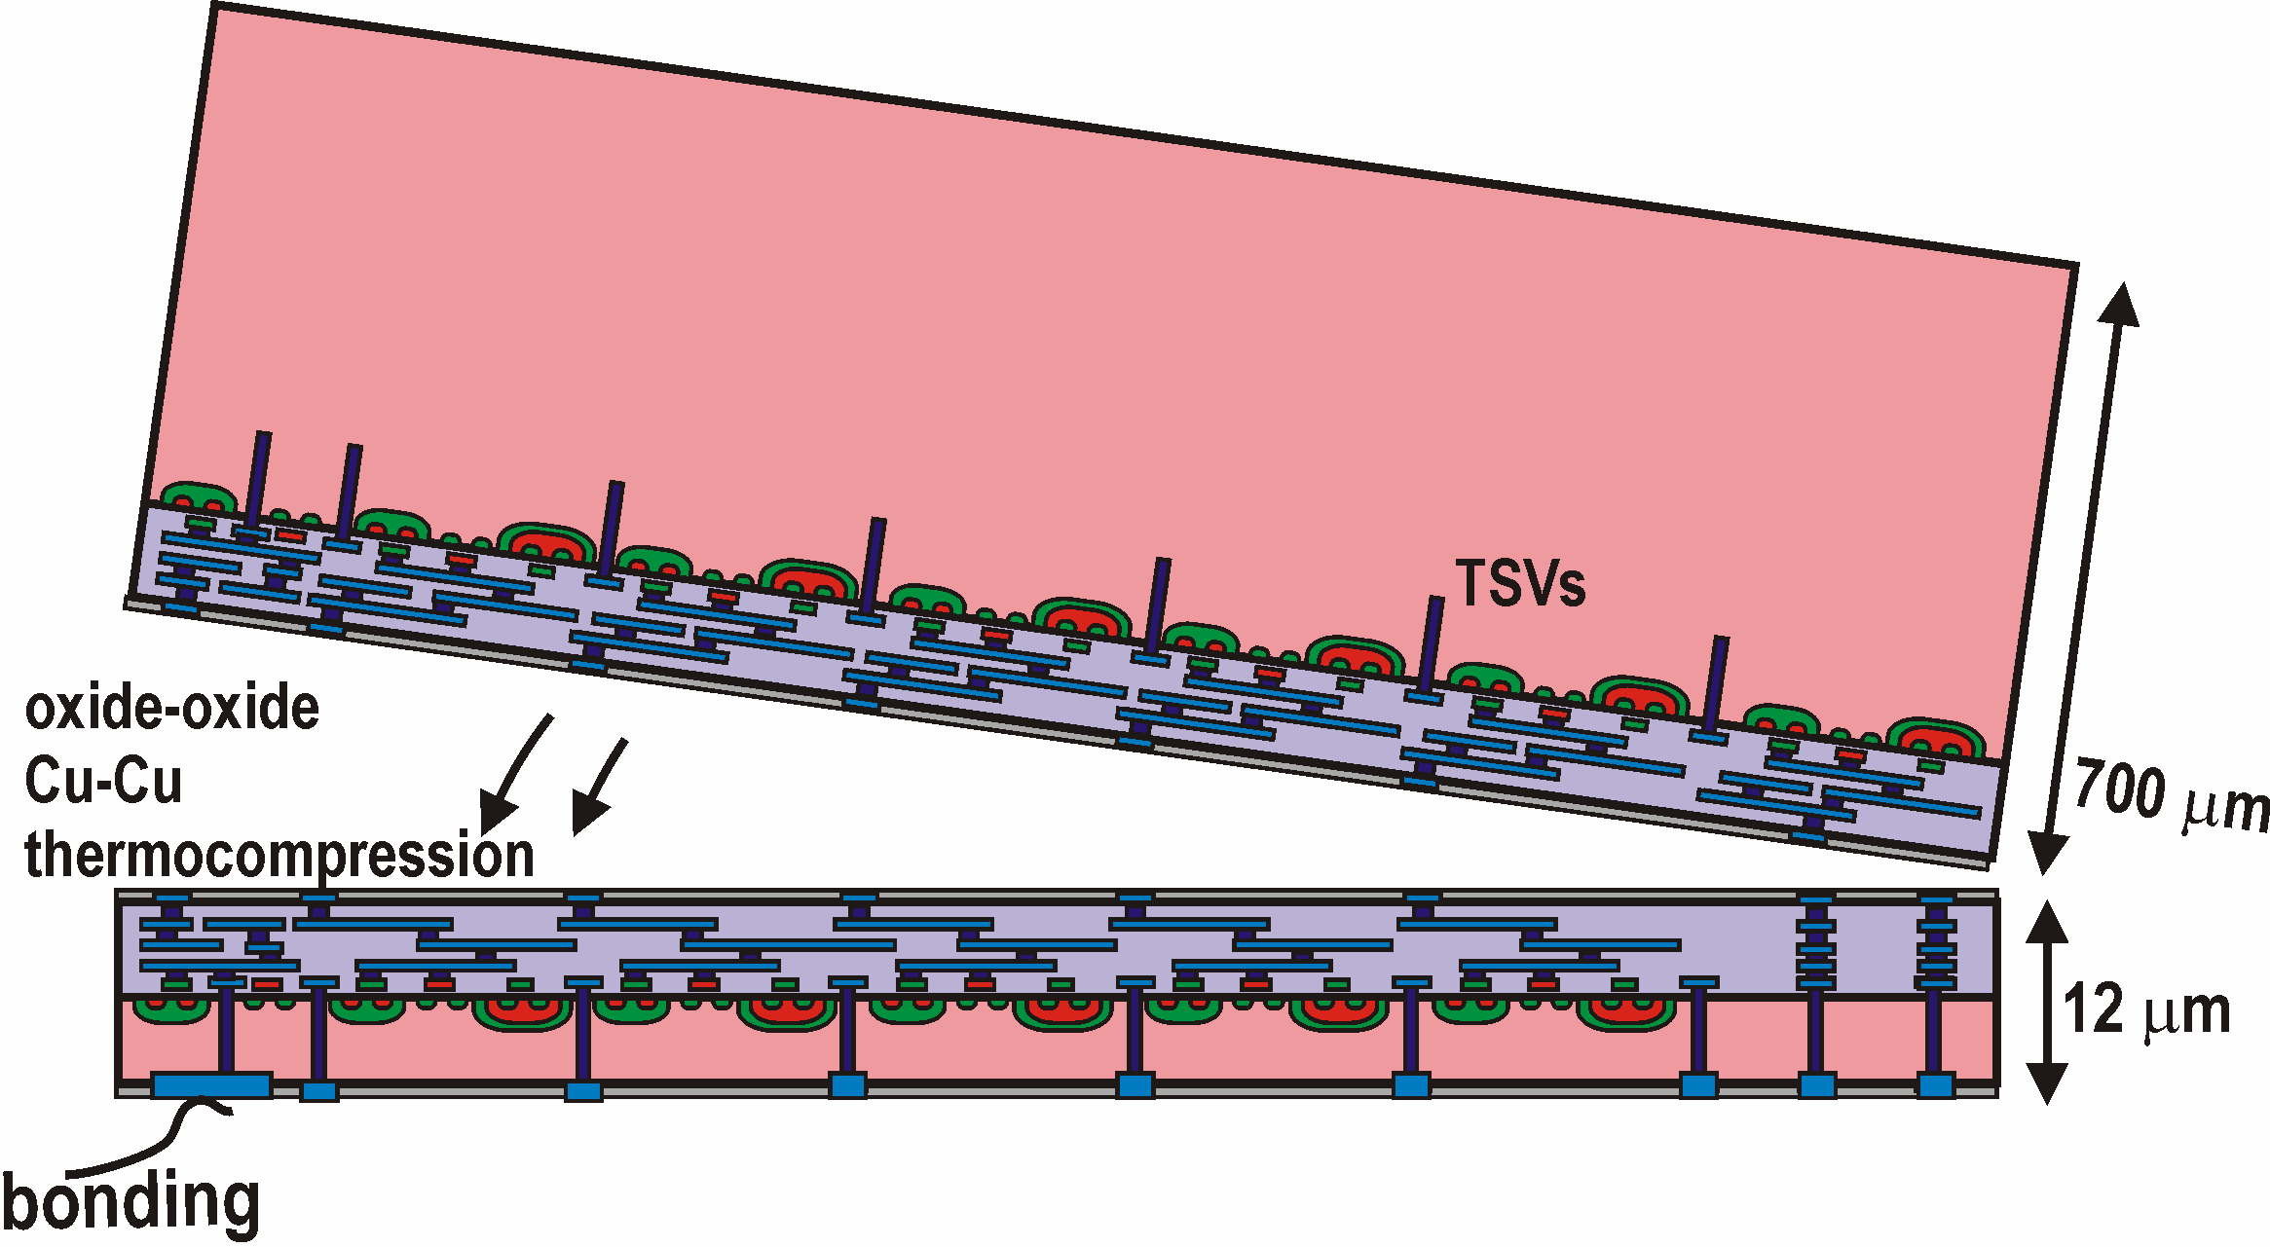
Difference between MIT-LL and Tezzaron technologies
Fermilab organized single
mask 3D MPW with
top and bottom chips on
the same reticle
(GF 0.13 μm LP bulk CMOS 2 tiers)
Through Silicon Vias added to wafers during in-fab at very early stage of technological processing)
Vias (φ=1μm) take minimum space, not blocking interconnects in TSV locations
Some concepts may benefit just from TSVs (no need of wafer stacking!)
TSVs can be added on preprocessed wafer basically from any foundry
First wafer
Face-Face
Via First with FEOL
or
Via Middle after initial layers of metals
Tezzaron
3D-IC process

Slide 31
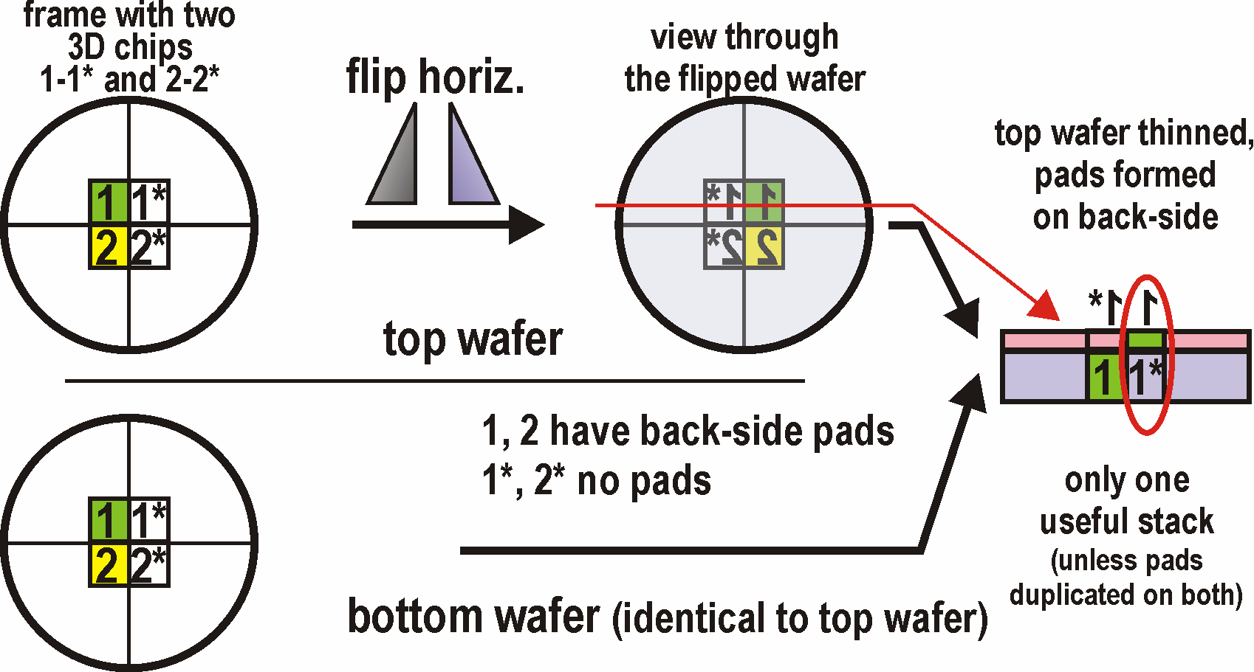
Fermilab 3D MPW approach
http:\\3dic.fnal.gov
Reticle divided in two halves containing top and bottom chips for cost efficiency
Advantages of using commercial approach:
Advanced process allowing reliable design of chips (design kits, models, documentation, yield, etc.)
8” wafers, large ~26×31 mm² reticule, 1P/6M (8M) + RDL, DNW, SM MIM Caps, LP (chosen), standard V_{T} + low V_{T}, + Zero V_{T} + IO MOSFETs, HR poly resistors, embedded TSVs
6th metal used as a bond interface for face-face Cu-Cu thermo-compression bonding

Slide 32
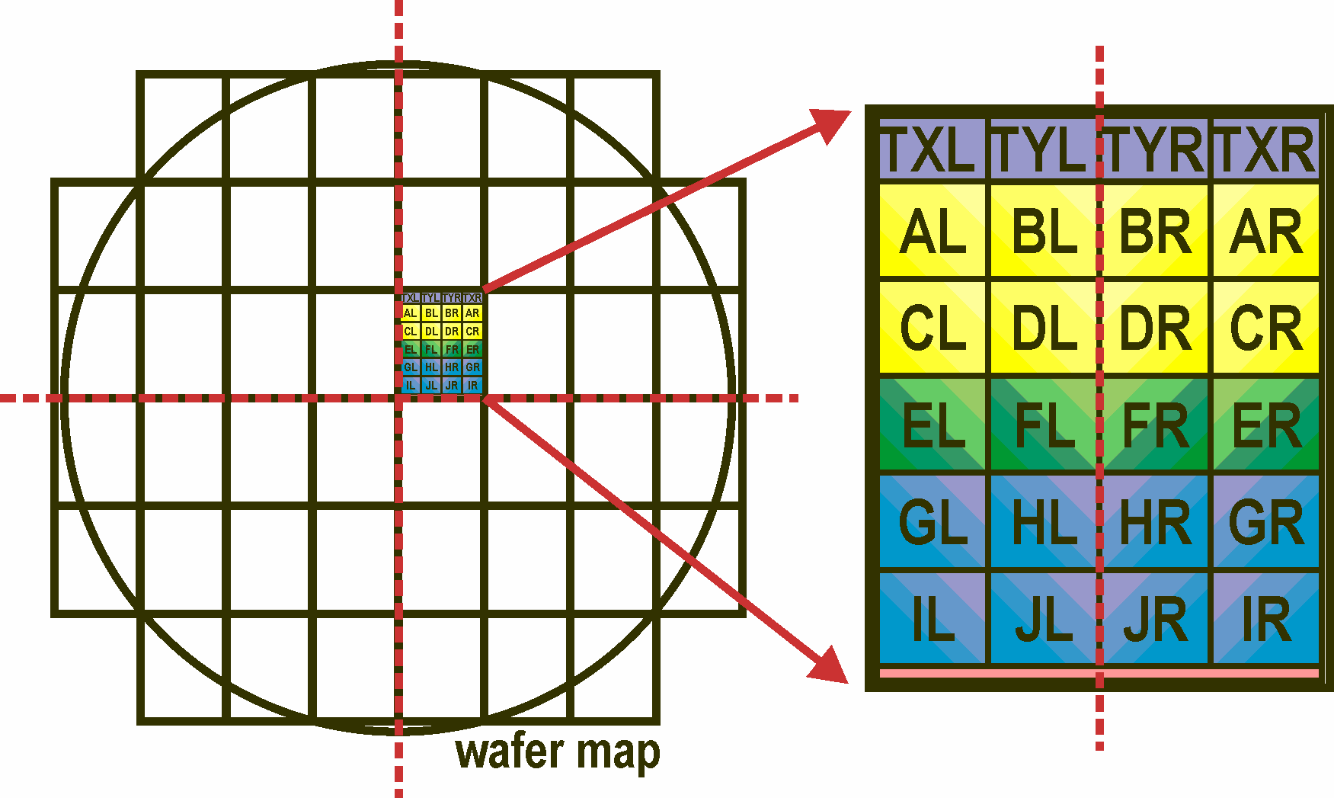
3D Designs
from Fermilab:
H = VICTR; short pixel realizing p_{T} cut for L1 trigger embedded in tracker
for CMS @ SLHC (HEP)
I = VIP2b; time stamping pixel for vertex detector @ ILC (HEP)
J = VIPIC; very high frame rate with sparsification pixel for X-ray Photon
Correlation Spectroscopy @ light source (photon science)
TX, TY; test structures (single transistors and subcircuits)
continuation with VICTR2;
first 2D VICTR2 preprototype
activity to be stopped
continuation with VIPIC2;
first 2D miniVIPIC2
TXTY2 on MOSIS 3D run

Slide 33
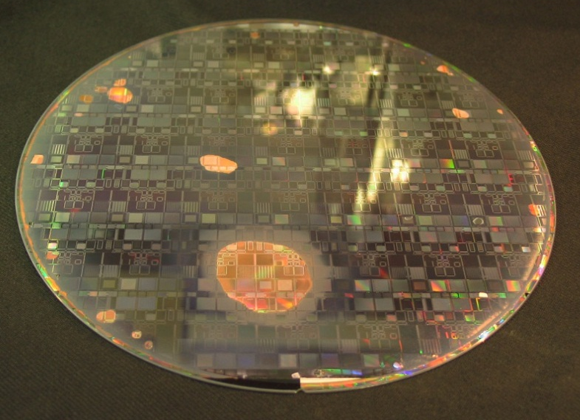
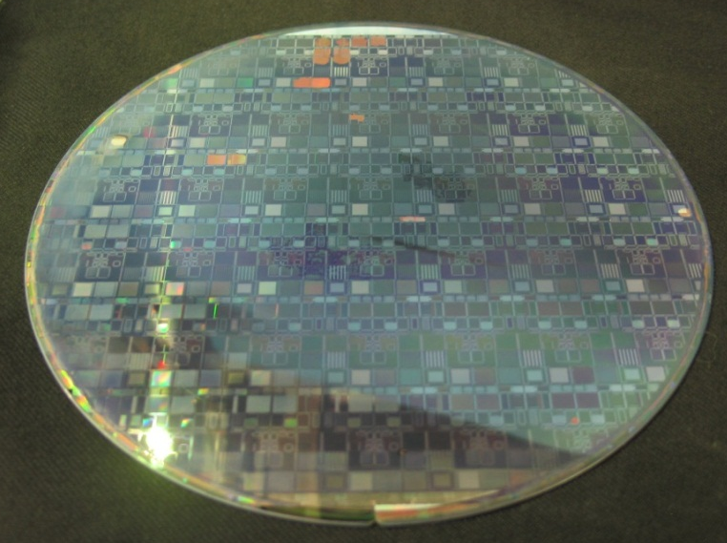
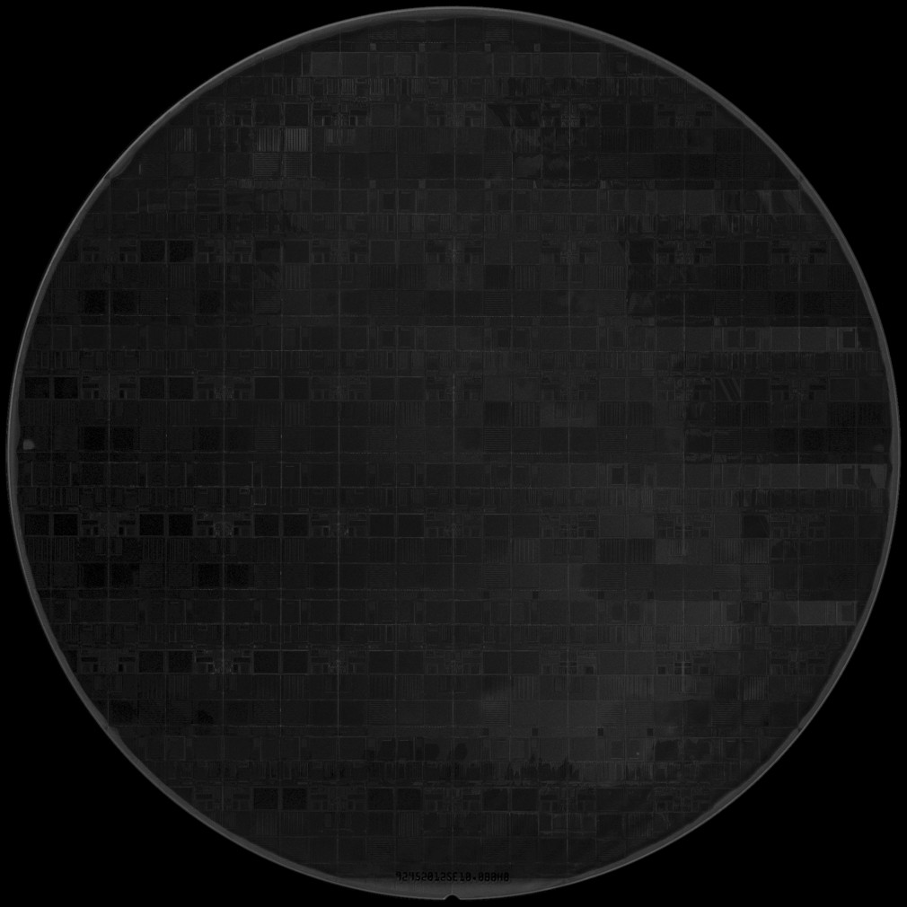
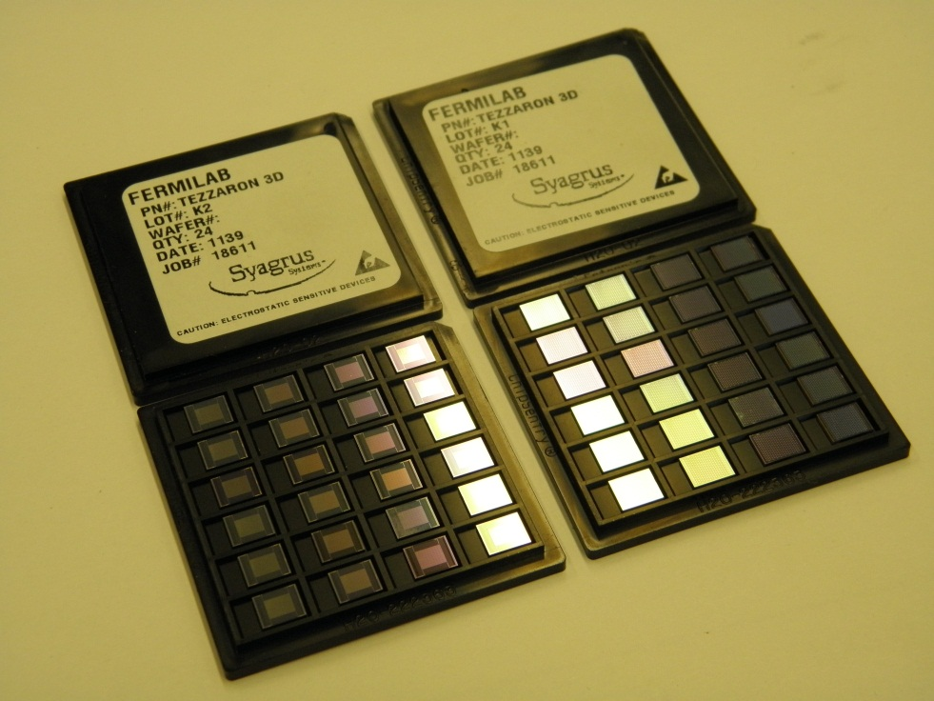
First two pairs of wafers
yielded assemblies with
blisters, cracks and
over etched area
Third assembly yielded
almost perfect Acoustic
Microscope image:
uniform dark indicates
uniform bonding
92319424SE10-0B0C7
92952214SE10-0B0C5
Wafer was back-thinned, and back Al pads were
deposited, then singulated and distributed

Slide 34
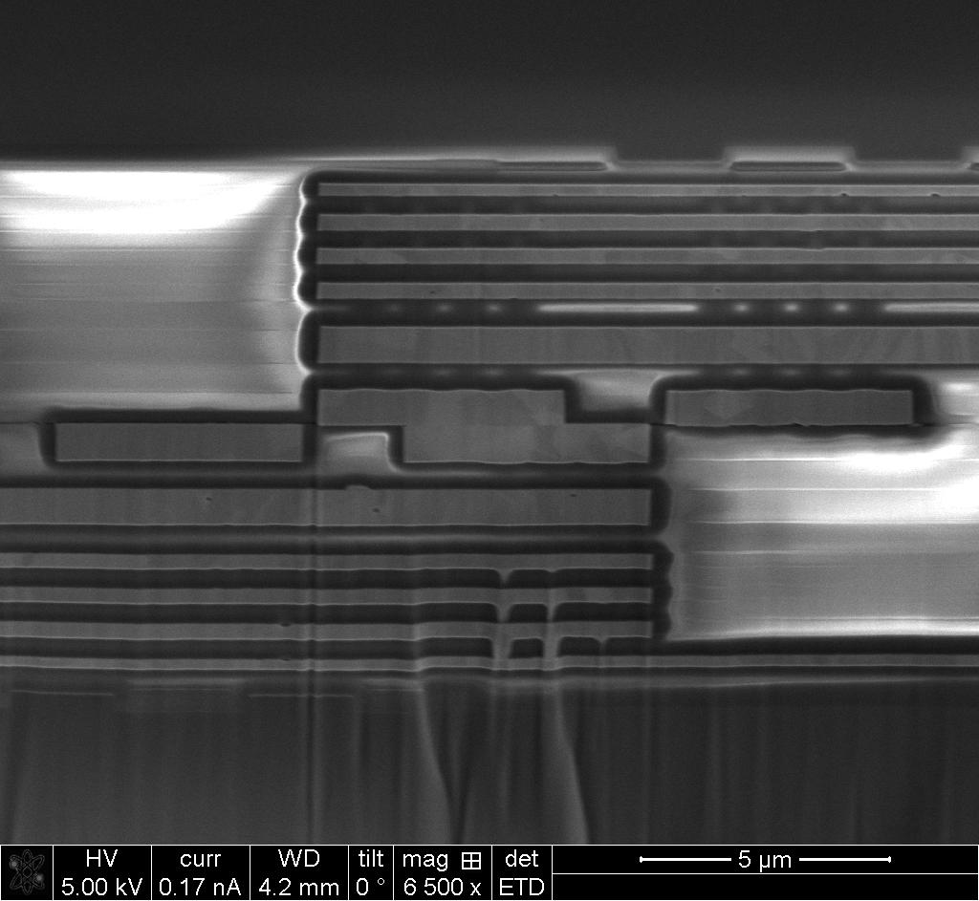
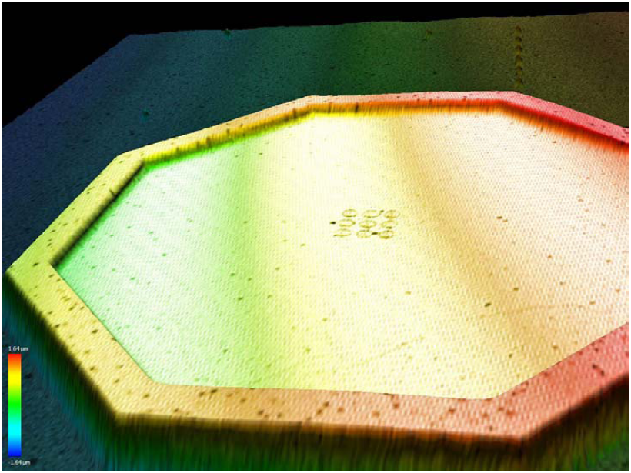
misalignment of bonding interface
Tests performed in all partner institutions revealed common problem: SHORTS
Some 3D circuits worked properly, but only those that had no small and tightly spaced connections between tiers
We were no slouch and try to analyze problem to improve it
Evidence of some misalignment of wafers was found, Tezzaron points to some defficiences of equipment
M6 top
M6 bot
Back-thinned
TSVs
oxide
Aluminum
SEM picture courtesy of P. Siddons BNL
Despite of misalignment in bonding of wafers, remaining (more difficult) parts of processing fully proven:
  Back-grinding down to TSVs’ tips
  Recession of Si to expose TSVs’s tips
  Deposition and patterning of back Al
  Deposition and opening of SiO₂ passivation
This message is super positive!!!

Slide 35

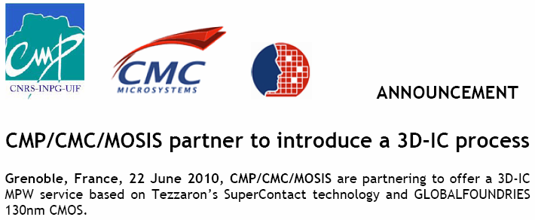
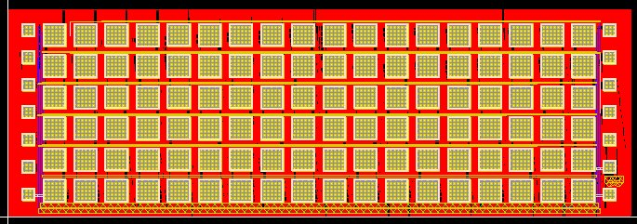
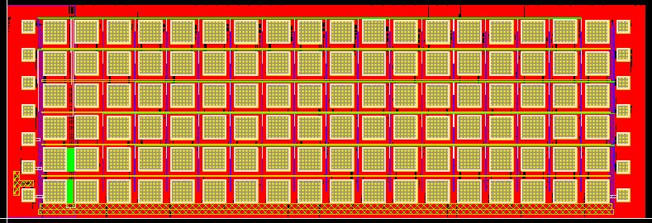
Benefit from Fermilab pioneering 3D-IC work
Fermilab has transferred knowledge to MOSIS/CMP/CMC to take over responsibility for future submissions
Fermilab is present on the MOSIS 3D MPW run with a small 2x6mm² test chip containing blocks of NMOS devices with layout optimized for characterization of HCE degradation (lAr TPC @ LBNE)
-- transfer --
TXTY2 bot
First MOSIS run taped out 11/2011 (CMP/CMC/MOSIS partnership) – 3D design kit built by CMP based on data from Tezzaron, NCSU and Fermilab and others
MOSIS after careful analyzes, concluded on positive outcome of the DARPA run and decided to carry out the submission for the customers!!!
TXTY2 top
35

Slide 36

Review of 3D designs in Fermilab MPW: VIP2b
Design migrated from MIT-LL to Tezzaron 3tier->2tier
  How it works:
192 × 192 array of 24x24 μm² pixels
8 bit digital time stamp (Δt=3.9 μs)
Readout between ILC bunch trains of sparsified data
Sparsification - token passing scheme
Single stage signal integrating front-end with 2 S/H circuits for analog signal output with CDS
Analog information available for improved resolution
Separate test input for every pixel cell
Serial output bus
Polarity switch for collection of e⁻ or h⁺
VIP Functional
block diagram
A
D

Slide 37


Fermilab MPW: VICTR
Vertically Integrated CMS Tracker
VICTR is response to need of much higher selectivity for trigger at HL LHC
Proposed idea: to discriminate on tracks of p_{T} exceeding
threshold (bent of track in B-field)
1mm
VICTR1 short
Pitch 80μm
5mm
VICTR1 long

Slide 38

Serial RO of all top & bottom strips + coincidence
Bump-bonding,
UC Davis
Interposer: Cornell,
AllVia, Tezzaron
The VICTR1 is a 3D prototype. It uses slightly modified front-end from FEI4 (ATLAS) with a custom serial RO architecture COLLABORATION!
Track-Trigger definitively needs 3D-IC technology and it must be multi-flavor 3D-IC (collaboration with vendors and institutions)
Sensors / edgeless sensors:
BNL, VTT
IC design:
LBNL
3D ASICs with TSVs:
Tezzaron
DBI/fusion bonding: Ziptronix,
T-micro, RTI
38

Slide 39
to work on VICTR2 now!
Future: VICTR2
Development (route designated by Marvin Johnson, et al.)
Readout Algorithm – it needs to be completed and it needs to be thoroughly simulated with realistic data and rigorously tested (Cadence AMS environment!)
Pipeline – it is aggressive and challenging concept. Asynchronous systems (newest, fastest ADCs are asynchronous) are very hot topic! Pipeline needs its own prototype (2D prototype planned) and it needs testing (it needs SEU and irradiation testing and developing of strategy for providing immunity radiation effects)
Front-end – its is not clear yet whether it will be required but specific requirements of VICTR need to be identified and if necessary, a new front end needs to be designed
Interposer, Si-PCBs, TSVs and bonding – choose one path and practice
Potential Roadblocks
Assembly of VICTR is an extremely challenging 3D project
3D-IC – trust in 3D-IC is still not fully established, strategy for 3D-IC design to learn
Asynchronous Pipeline - asynchronous logic can be fast, low power and more quite wrt. clock distributed systems. Challenges to overcome are glitches and hazards (not present in synchronous logic) – need to learn how to do and which tools to use
Radiation & Single Event Upset Tolerance – loss of data is acceptable if it is small enough, but loss of control is unacceptable. Nobody has shown that asynchronous logic can be SEU immune – strategy (equivalent to triple voting logic) must be shown is possible…

Slide 40

Fermilab MPW: VIPIC1 … VIPIC2
Vertically Integrated Photon Imaging Chip
Why do we have VIPIC project (Intention of collaboration from Peter Siddons BNL)
There are users who would do science on photon source immediately
There is no comparable device available (2D autocorrelation @ ~10μs sampling)
Allows maintain collaborative efforts with other institutions (BNL, AGH-UST)
Allows exploring and applying in-vivo beneficial features coming with 3D-IC
Beam and DAQ are ready for VIPIC1
Standard XPCS analysis: multi-tau correlator
Probes correlations between intensity fluctuations at times 0 and 0+t
time
The CHX beamline is designed to work with 80-100 μm pixels size (well, up to ...)
“VIPIC” detector is the single most important element of the CHX beamline
High dynamics range “Pillatus-type” needed for CDI, XSVS & (μ-beam) SAXS applic.
Sub-μs resolution is required for studying for e.g. capillary-wave dynamics. An APD or small APD array could fulfill the need on “day 1”. We hope that eventually a ns-VIPIC would become available!
40
From BNL

Slide 41


VIPIC1
Pixel 80x80 μm²
1400 transistors / pixel
280 transistors / pixel
Digital part of pixel
Analog part of pixel
Power supplies transferred between tiers; 25 connections between tiers for signals in each pixel
Full separation of analog and digital achieved by dividing functionalities between tiers

Slide 42



VIPIC – NOW:
pads are
duplicated
VIPIC –
FUTURE:
no classical
Padring
4 side
buttable
Our goal is this aggressive mounting option!

Slide 43

  Design optimized for 8 keV X-ray photons
  (range up to 3 × 8 keV with Si detector)
  64 × 64 array of 80 mm² pixels 5120 × 5120 mm² active surface; die size 5.5 × 6.3 mm²
  Shaping time t_{p}=250 ns, power consumption ~25 μW / analog pixel, Noise <150 e⁻ ENC
  Two modes of operation:
  1) timed readout of hits acquired at low occupancy (address and hit count)
  2) imaging (two 5 bit-long counters / pixel accumulates hits occuring in each time slot, readout uses sparsification mechanism but no readout of addresses tread= (fclk)-1 × 16 bits × 4 × 64 – can be <100 μs)
  Dead timeless operation (operation divided into time slots: hits arriving in time Δtn-1 are read out in Δtn while simultaneously new hits are being acquired in time Δtn)
  R/O Architecture:
  64 × 64 matrix divided in 16 submatrices of 4 × 64 pixels
  16 parallel LVDS
  Sparsified readout with priority encoder circuit (binary tree) with automatic binary-coded generation of hit pixel addresses
  Hit pixel address readout only (no energy information available)
achievable
Timing
1-10μs
depending on
occupancy

Slide 44



VIPIC2
Charge sharing is Higgs equivalent challenge in X-ray pixel detectors
Charge sharing affects (degrades):
  Spectroscopic performance by degrading energy resolution ΔE/E
  Timing resolution by time-walk in discriminators
  Detective Quantum Efficiency (DQE) by degrading S/N due to possible detection of multiple hits
The challenge of defeating charge-sharing was attempted by the designers of Medipix3, although they succeeded only partially
Central hit
no Ch.Sh.
Side hit
max Ch.Sh.
Threshold scans
0.7 0.8 0.9 1.0 1.1
Vcmp(V)
courtesy of R. Dinapoli, PSI

Slide 45

Goals for VIPIC2
Provide improved timing resolution by TDC per pixel
Maintain parameters comparable to other pixel ROCs
Implement reconstruction of full X-ray signals for leading edge discrimination
targeted
timing
~10ns
depending on
occupancy
Timing from leading edge discrimination
Hit allocation from comapring neigbors

Slide 46



Algortihms for retrieving full signal and correct registering of hits were analyzed
Thorough investigations of several algorithm were done:
  Missed hits - Noise hits (fake hits)
  Feasibility of in-hardware implementation

Slide 47



Conceptual design
of VIPIC2 pixel
Layout optimization
requires extremely
compact digital cells.
New library built, and
it will benefit other
projects e.g CMS pixels
Submission of miniVIPIC2
miniVIPIC2 2D chip with 100x100 μm² pixels is pursuing (with AGH-UST Krakow Poland) awaiting VIPIC1 for tests and new 3D-IC MPW run
Submission to GF shuttle run through Tezzaron asap
ORIGINAL DFF
COMPACT DFF

Slide 48


Beneficial aspects of 3D technology for detectors
Bump-bonding vs. fusion bonding (DBI®, SLID, or metal thermo-compression bonding)
thinner and more transparent detectors
  Classical SnPb or In bump bonding do not provide enough mechanical rigidity for post-processing
Thinning of wafers prior to bonding does not hold due to handling issues; use of handle wafers is required
Shearing forces present at: grinding (thinning) and separation from handle wafer are deadly for bump bonded structures
  Wafers brought in contact by 3D-IC fusions techniques (3D-IC bonding) are as rigid as monolithic structures
Sensor wafers (chips) can be mechanically processed after bonding (thinning), back implanted and laser anealed to activate doping, thinning can be applied to ROIC wafers too,
Reduce multiple scattering effects:

Slide 49

Strategic development: 4 side buttable, dead-area-free detectors for applications ranging from X-ray, visible, IR imaging to classical tracking
3D technologies can also be used to integrate sensors to ICs
Pitches as small as 3μm, thinned to 25μm
Provides for fully active sensors as large as 6” (or 8”
Direct Bonding Interconnect (DBI®) by Ziptronix oxide-oxide W-W bonding
VIPIC
Collaborative effort: FNAL - BNL - AGH-UST (Poland)
Sensor wafer for 3D pixel chips from the MPW run
(designed at Fermilab fabbed at BNL),
49

Slide 50

Sensor fabricated at BNL (Peter Siddons and Gabriella Carini) in exchange for VIPIC1 chip
Fermilab provided mask designs for HW (sensor) and for DW (3D chips)
  Design and fabrication of sensors:
    Planarity is of extreme importance. Surface topography should not exceed 500 nm
Sensors are 500 μm
p-on-n, developed for 3 chips at the same time: H (VIP), I (VICTR) , J (VIPIC)
Sensor design includes 1 metal layer (shielding by filling empty spaces between diodes in ‘with shield metal’ option)
Fanout routing to the external pads realized on Ziptronix seed metal layer
C-W bonding
With shield metal
Without shield metal
VICTR Top
sensor
VICTR Bottom
sensor
8 mm
VIP
sensor
Significant effort
All arrangements with Ziptronix done by FNAL
VIPIC sensor
in progress, high priority but delayed by Tezzaron

Slide 51

Monolithic detectors in SOI
Silicon-on-insulator (SOI) devices with high resistivity (up to 10kΩcm FZ) detector handle wafers – OKI Semiconductor (now LAPIS) SOIPIX collaboration led by KEK (US-Japan Collaboration Funds) + ASI (SBIR)
Truly integrated sensor/electronics - Monolithic structure: minimal interconnects, low node capacitance
Supplementary / complementaty for 3D work (can be first layer of 3D)
Can be back-thinned, back-side implanted,
laser annealed, metalized - demonstrated by Fermilab
particularly suitable:
minimum scattering and
low energy range (soft X-ray detection)
Multi-year program at Fermilab:
5 prototype, pixelated
structures developed
and submited over last 5 years,
2.5×2.5 mm² and 5×5 mm²,
MAMBO
Monolithic Active Matrix with Binary Counters
51

Slide 52


The potential of the substrate can change the fields at the top transistor and affect performance – “back-gate”
Back-gate effects are significant in OKI process - limit bias that can be applied
Digital-analog coupling can also destroy performance
FNAL suggested process changes to OKI to fix this
Tests show the chips are not affected by back potential any more
This well separates digital circuits
from sensor substrate and
prevents back gating effects
This well collects the charge carriers
Patent application under
discussion OKI-KEK-FNAL
SILVACO
process simulatiom
No shift of NMOS transistor I_{DS}/V_{GS} in nested wells at diff. back-gate biases
52

Slide 53
MAMBO : Monolithic Active pixel Matrix with Binary cOunters
ANALOG
Analog Buffer
Multiplexed Output available at PAD during Calibration mode
PREAMP
SHAPER + BLR
Shaper Output
Tristate Output Buffer
Multiplexed Output available at PAD during Calibration mode
X-ray imaging counting pixel chip with window discriminator
(f_{MAX}= ~ 1 MHz)
Each pixel: CSA, CR-RC² SHA, window discriminator + 12 bit binary counter
VthH
Previous pixel
Trimming DAC (4bit) (Diff. CS), Control I_{ds} to remove offset in V_{gs}
CountClock
DOUBLE
Discriminator
LOGIC
(DDL)
COUNTER/ SHIFT REGISTER (13bit)
Shaper Output
Trimming DAC (4bit) (Diff. CS), Control I_{ds} to remove offset in V_{gs}
VthL
Shift Clock
Next pixel
Preamplifier I/P test capacitor
(3-8) bit decoder
Pixel Configuration Register (11bit)
DAC-H D<0:3>
DAC-L D<0:3>
Calibrate (3 bit)
000-Normal Operation;
001-Analog Output; 010-test input to counter; 011-CompL; 100-CompH;
111-pixel disable

Slide 54



MAMBO III: vehicle for exploring μbump-bonding with T-micro
MAMBO III : Top chip: Electronics
single pixel (100µ x 100µ); ~950 transistors
5x5mm², 44x44 pixel matrix
T-Micro: 3D AuIn µ-bump bonding – not really hope
to have this path accomplished!!!
Bottom chip: matrix of detector pixels, no bond pads
contains only micro bump pads, aligned with the top
chip top chip: Pads with back metal opening
MAMBO III : Bottom chip: Detector

Slide 55


Achievements and plans:
The process has been improved:
  High resistivity FZ 7.1 kΩcm material
  Back gating remedied with BPW and
  nested BNW/BPW
  Improved PDK and models
Some positive results have been obtained
Design of the pixel and of the chip have been mastered; gained experience in pixel detectors and verify process improvements,
and alternative ways of detector biasing
MAMBO III, IV, V pixel
105 μm
Attractive detector R&D
SOI process by OKI can be used for further R&D work
There are domestic opportunities (ASI with JAZZ, Honeywell)
continuation can be shifted into the background in the case of crystallization of the priority projects
  FZ 7.1 kΩcm ~485 μm
55

Slide 56
Look at the future: CMS pixels for HL LHC
CMS Pixel ROC: context/motivation
LHC luminosity is (finally) high and getting higher fast
  Current ROC will lose data
  New version (evolutionary) in development at PSI for “Phase 1” replacement of pixel detector (4 barrel layers, 3 disks, CO2 cooling, digital readout)
Current sensors (not ROC) will die
  Inner layer lifetime ≈ 1 year at 2×10³⁴/cm²sec
  High Luminosity (HL) LHC luminosity = 5×10³⁴/cm²sec
Many L1 triggers will lose necessary selectivity
  Electron/Tau trigger might be possible using data from a small fraction of the pixel detector (region of interest (ROI – know from some imaging applications) readout followed by fast reconstruction of stiff tracks)

Slide 57
CMS Pixel ROC: Goals
Precise goals are under discussions
High radiation tolerance (~10¹⁶/cm² ≈ 10× current; this is primarily a problem for the sensor (thin Si planar, 3D, planar diamond), but ROC must be matched to sensor – 1Grad level!)
High rate capability (~1% data loss at 1.5 GHz/cm² - 10× current; slow degradation at higher rate)
Smaller pixels (current = 100μm × 150μm) – limits must be delineated
Support for intermediate level (region-of-interest) trigger

Slide 58

CMS Pixel ROC: Initial R&D Strategy
Radiation tests of transistors & simple circuits in a variety of 130nm & 65nm CMOS processes (rad-hard guidelines for 130nm were not carefully drawn)
Extract guidelines (such as when enclosed geometry transistors are required)
Develop circuit elements to explore limits of
  FE noise
  Signal speed
  Power requirements
  Size requirements (pixel size; size of periphery)
  Minimum achievable discrimination threshold
Simulate readout architectures
Understand readout interface requirements (GBT)
Explore use of (ATLAS) FEI4 circuit elements (work with FEI4 folks)

Slide 59

CMS Pixel ROC: Collaboration
Circuit design:
  2 “lead” institutions: FNAL & Torino (Torino started already Verilog based analyses for architecture) + contributions from other Italian groups
  PSI participation; at least design review/consultation
“Physics” Simulation:
  CMS Monte Carlo studies (sensor, readout, trigger)
  FNAL, US Universities, Italian groups
  Simulation of thin planar sensors
  JHU

Slide 60





Slide 61





Slide 62
CMS Pixel ROC: Short Term Goals
Green light for CMS Pixel ROC means that efforts should start without any delay
Initial efforts at Fermilab:
  Analyze pixel size (limits for smallest size noise (capacitance) vs. power)
  Get NDAs signed for set of 130nm and 65nm processes
  Build and submit radiation characterization tests structures
  Complete acquisition of X-Ray irradiation station (Al. Baumbaugh is preparing sound proposal for building this facility)
  Perform irradiation studies
  Match work on architecture (use integrated mixed-mode simulation environment + synthesis and router)
Expect activity to be funded by generic R&D funds in FY12, mostly by CMS in FY13, exclusively by CMS in FY14 & beyond

Slide 63
Cold electronics for lAr TPC at LBNE
Technology for in liquid Argon operation:
Depending upon strategic decision on technology (water Čerenkov vs. lAr TPC), Fermilab, sharing responsibilities with BNL may be involved in developing integrated readout electronics which need to operate at cryogenic temperatures
BNL – responsible for front end part (analog + ADC + first buffering), Fermilab – responsible for digital multiplexing and transmission of data to outside of cryostat
Lifetime reliability is brought anticipated challenge, hot carrier effects (HCE) at cryogenic temperatures è decrease of lifetime
First step, which seemed to be most sensible in waiting for decisions for detector technology, was to make studies of process technology that would be, as much as possible, immune to HCE degradation and to develop design techniques to avoid exposure to such damage
Strategic (macroscopic understanding) goals of process evaluation were achieved. There is recommendation (Veljko Radeka, BNL) to deepen the understanding, clarify on correctness of predictions under stressing, make precision measurements – dedicated, optimized tests structures submitted on the MOSIS 3D-IC MPRW run in Nov. 2011, need cryo-cooler to allow conveying measurements in robust conditions
Actual work on the electronic design can start when technology decision is made. Starting point could be the GOL chip (designed by CERN for LHC) database of which was obtained from CERN – manpower is needed (source: collaboration with SMU)

Slide 64


Tests performed on 0.13 μm Global Foundries transistors from TX and TY chips from 3D-IC MPW run translated to broader analyses due to complex nature of observed mechanisms – colse collaboration with experts from Georgia Tech.
Lifetime is derived from limited time measurements under worst stress conditions and extrapolation of lifetime towards full time of the experiment operation (criteria for end-of-life are to some extend arbitrary)
The results show that the difference in lifetime for room temperature operation and cryogenic operation for this process are not great and the lifetimes at both 300K and at 77K can be projected to more than 20 years at the nominal voltage (1.5V) for this technology
LBNE will be able to rely on three mainstream CMOS or BiCMOS processes (0.18 μm TSMC studied at BNL, with a tested ASIC prototype for MicroBooNE, 0.35 μm IBM studied at Georgia Tech, and 0.13 μm Global Foundries studied at FNAL).
64

Slide 65



3D SiPMs
analysis provided by Paul Rubinov
Dual Readout
Calorimetry
Fermilab and SiPMs
μ2e calorimeter, cosmic ray veto
3D SiPM technology
Čerenkov Telescope Focal Plane
3D SiPM technology
g-2 calorimeter
are we able
to be
competitors on
medical market?
I doubt …
Digital SiPMs useful in all this applications

Slide 66
Common features available in 3D SiPMs
Possibility of thin entrance window or back illumination è UV sensitivity and FF
Digital response pixels è reliability and noise suppression
Practice teaches that majority of the noise (dark current) comes from a small fraction of pixels è digital pixels would allow individual pixels to be turned off
Digital pixels è excellent timing (because C_{D} is so small)
Active quenching è control of after-pulsing
Less excess noise, better dynamic range
Conclusions:
ALL of the features above can be achieved with 3D SiPMs
  Back illuminated: simplest 3D face-to-face bonding of sensors to readout IC
  but sacrificed timing and QE (thermal diffusion and recombination)
  Front illuminated: more difficult back-to-face bonding
  photons get directly where avalanches are produces (need TSVs)
BENEFITS: active quenching, digital readout, pixel kill
3D SiPMs are an example of
Application Specific Integrated Circuit è pick SPECIFIC APPLICATION , but technology is broadly applicable
g-2 is ideal: real experiment, real need, real advantage for digital SiPMs

Slide 67

g-2 calorimeter
Fast - able to resolve showers a couple of ns apart
  Use Čerenkov radiator such as PbF₂
  Use some segmentation to reduce overlap probability
  Use digital SiPM to achieve excellent timing
Very stable over the length of the spill (few 100 μs)
  Use digital readout of number of photons
  Use active quenching to remove live time uncertainty
Relatively good energy resolution (15%)
  UV sensitivity and high FF
be insensitive to B fields and low power
at very high speed (not disturb B field)
3D SiPMs are a PERFECT for g-2
Fermilab approach
Back-to-Face bonding
with TSVs
VoXtel approach
Face-to-Face bonding
with SOI material
(Fermilab is in collaboration
through SBIR no work for ASIC group)

Slide 68


Fermilab approach: Back-to-face bonding
Agree with industrial partner or other technology vendor e.g. SNL
On providing full wafers with SiPM diodes only (optimized) - available
Process obtained wafer including insertion of TSV
Fabricate wafer with electronics (with TSVs)
Realize back-to-face bonding, build back-side pads, singulate, build module, etc.
work on 3D SiPM would allow exploration
of building large ‘seam-less” modules

Slide 69
Process flows for Fermilab 3D SiPMs
Illustration of processing on ‘virgin’ SiPM wafers from SiPM foundry
Practice of back-to-face bonding
Practice of Back-to-Front
on dummy wafers
Processing on SiPM
wafers

Slide 70

Conceptual view of Fermilab 3D SiPMs (image/detector plate)
Front illumination
TSV
Practice of bonding used as
‘TSV Science’ vehicle:
TSV daisy chains (Ω and reliability)
Inter-digited structures for capacitance
V_{Break-down}, heat transfer enhancement, etc.
Cross-sectional View
Top Metal
Bottom Metal
TSV
Capacitance calculation
Conceptual Model
Recent estimation:
Test wafers in fab ~1yr ($70k)
Wafers finished
end of December 2011
3D bonding (no alignment need)
February 2012
Tests (need manpower) !!!!
substrate

Slide 71

Collaborative efforts: ANL
Commited Developments
QIE10 - in progress, converged on a common design between ANL/ATLAS and FNAL/CMS, probably most of the design work in FY12, one more prototype fab run at the end, production is uncertain, target is to test in test stands and test beams, possibly installing a few hundred channels in the 2018 shutdown, target upgrade is for Phase 2 - ~2022, CMS wants to install everything in 2018, to have the chips tested again using the robot. The funding for the design work is probably OK for 2012
3D CAM - ATLAS FTK, new CAM memory will be needed for Phase 2 (more patterns and lower power), there is funding now to support some of this work, definite plan under preparation incl. costs and efforts, at present, there is support for ~0.3-0.5 FTE for a couple years (not sole support of entire development will be possible), this might change if the current CAM development (being done by another group) gets into trouble for a 2015 installation...

Slide 72
Possible Developments
DCAL4 - next level with DCAL (readout chip for RPCs - fine-grained hadron calorimetry), it would need to have σ_{t}=1ns (currently 100ns), and substantially lower power, there is not funding for this yet, but ANL is working on it, possible start = 2013
Multi-channel front-end ASIC for highly-pixelated calorimeters - extension of DCAL, but instead of a 1-bit discriminator, it would have charge digitization, perhaps 16 channels, there is no funding for this yet, but the development would fit into some other aspects of ANL detector R&D program, probably looking at out years for this
Wireless RF data transmission, currently commercial devices are used, to integrate the front-end electronics (charge digitization) with the data transmission front-end (not the transmitter), single channel chip, and below power, there is no funding for this now, but ANL is working on it.
Argonne – Light Source Project
Light source activities had difficulties with organization of project
Fermilab did design, fabricate and test superior sensors for fuel spray application
No future plans at this time. Possible future work with Marcel Demarteau and/or
Sandia National Laboratory

Slide 73


Tracking with Content Addressable Memories (CAM)

Slide 74





Slide 75



Slide 76


CAM (VIPRAM) development has multiple focus points:
Multi-layer 3D stacking technology of potentially heterogeneous components (memory chips, controller chips, driver chip, DRAM/SRAM and FPGA)
CAM architecture and circuit design (revisited fundamental architecture of CAM)
ANL and FNAL must work out a plan with milestones over a few years
This is an ambitious endeavor, costly, and risky; the risk is in aggressive exploration of building 3D architecture, there is less risk in circuit development
If 2D CAMs proven inadequate è 3D CAM is the only way!!!
76

Slide 77



Impact on the field
Most recent:
2011, IEEE NSS, Valencia, Spain
submitted to IEEE Trans. on Nucl. Sci.

Slide 78
Peer reviewed papers (2008-2011)

Slide 79
Conference and other papers (2008-2011)
not complete
Members of the group are presenters (also invited presenters) at conferences, topical workshops, meetings and working groups: IEEE NSS & MiC, VERTEX detectors, VIPS, FEE, GOMACTech, TWEPP, TIPP, Pixel Detector Workshop, CMS and ATLAS working group, etc.
More participation in IEEE EDS and SSCS should be targeted

Slide 80
Needs to continue and to sustainably grow
Tools
Investment unavoidable in CAD/EDA; due to changing technologies, tools must continually be upgraded. We have reviewed and upgraded tools in each of the last 3 years. Still not at same level as microelectronics at CERN
- digital design / chip floor-planning / mixed mode automation (at given moment trade off between more load on human without tools and use of tools breakes down)
  Looking at SoC Encounter from Cadence / VDIO from Cadence or TALUS/TITAN from Magma (to be acquired by Synopsis)
Hardware changes; computers / centralized (BlueArc) storage / network upgraded and equilibrium achieved (appreciation to Rennie Scott)
  Operation of replacing machines expected within 3-4 years from now
  CMS pixel development will require investment in new tools at Fermilab
People
Students!!! ASIC Group must have students (Post-Doc/Phd/Grad), examples of Guoying Wu (SMU), Ethan Stanifer (MUOHIO), Gokalp Menis (NWU) proved that this virtual extension of the group is beneficial for both: projects and students! Some things can only be accomplished with fresh ideas and extra hand coming from the students.
  What arrangements can be made for students? (so far personal contacts dominate) – how joint PhD programs can be offered? (ex. CERN)

Slide 81
People
Personnel:
  extension of the group:
      residence of a key person to provide help linking to the experiments,
      1 or 2 experience persons in ASIC design, 1 person for tests
    invite experienced people from other institutes for a few-month-stays with the group (under umbrella of collaborative efforts and exchange of experience) – there are candidates, need to facilitate arrangements
Infrastructure
Investment unavoidable in CAD/EDA;
  Both being able to use industry standard tools and maintaining proficiency are essential but costly and require time management (training - design)
  We are trying to negotiate SoC Encounter RTL synthesis and R&R Cadence equivalent tool:
    TALUS/TITAN from Magma (contract with MAGMA probably needs to be extended to maintain current favorable pricing)
    directly Cadence tools

Slide 82
Conclusions
Microdetector Electronics <-> ASIC + solid state detectors instrumentation
People’s skills are essential! The ASIC group is cohesive and productive
HEP projects have been difficult to find in the last 3 years. Work has progressed on all the projects that were available to us. (We were invited to work on INFN B factory but told we could not).
Interesting R&D projects were found to take up the slack time and allow us to become leaders in new areas like 3D circuits.
Interesting projects are needed to maintain the vitality of the ASIC design group.
Personnel development and tool enhancements are essential for success.
Collaborations and serving broad communities are essential “flee to the front”
Modern test hardware and design software is crucial and needs continuing investment
Important to maintain healthy balance between R and D
- provide experiments with readout electronics – and - develop new technologies for future (often multidisciplinary skills are needed)
Difficult with decades between experiments - some projects with shorter timescales
I would like to thank everyone who helped with preparation of this extensive presentation: Al Baumbaugh, Dave Christian, Marcel Demarteau, Gary Drake, Christian Gingu, Jim Hoff, Scott Holm, Farah Khalid, Ron Lipton, Paul Rubinov, Alpana Shenai, Peter Siddons, Marcel Trimpl, Ray Yarema, Tom Zimmerman

