Slide 1
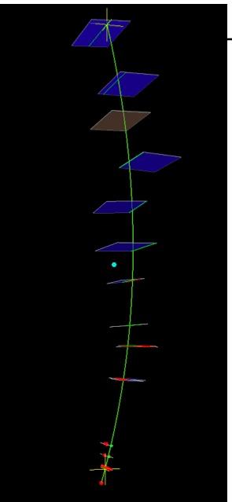
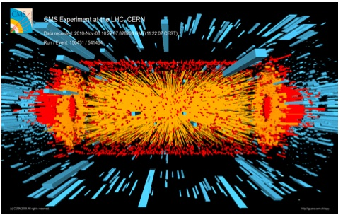
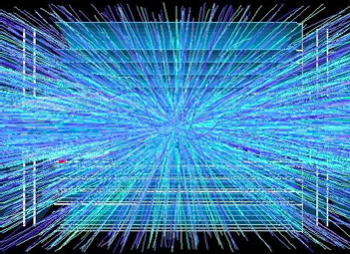
HL-LHC Tracking Trigger Challenges
→ the view from science and technology
Originally assigned title: “New Trigger Architectures”
Ted Liu (FNAL)
APS meeting,
April 7th, 2014

Slide 2

Some colliders in the past
Quarks
Force
Carriers
Leptons
SLD/SLC,
(Aleph,Delphi,Opal,L3)/LEP
AdA,
VEPP,
ACO,
ADONE,
CEA
…
KLOE/DAΦNE
(JADE,MARK J,
PLUTO, TASSO)/PETRA
MARK/SPEAR,
BES/BEPC
CLEO/CESR,
Argus/DORIS
BaBar/PEP-II,
Belle/KEK-B
…
(AMY,TOPAZ,
VENUS)/TRISTAN
ep (H1, ZEUS, HERMES, HERA-B) /HERA
pp-bar (UA1, UA2)/SppS, (CDF,D0)/Tevatron
pp (Atlas, CMS, ALICE, LHCb)/LHC
Trigger challenges at high luminosity:
e+e-, ep colliders: beam background
pp-bar, pp colliders: pile up & pile up

Slide 3
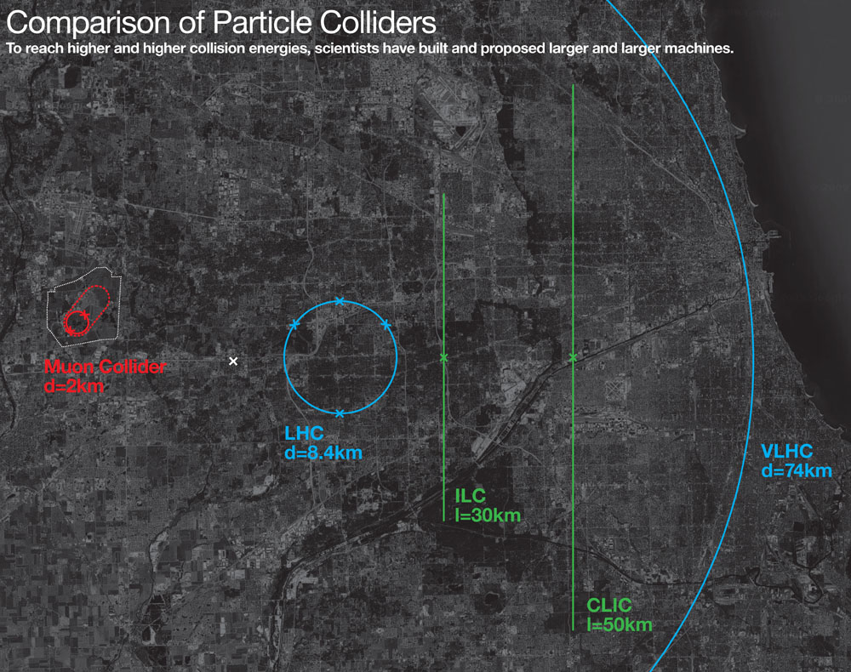
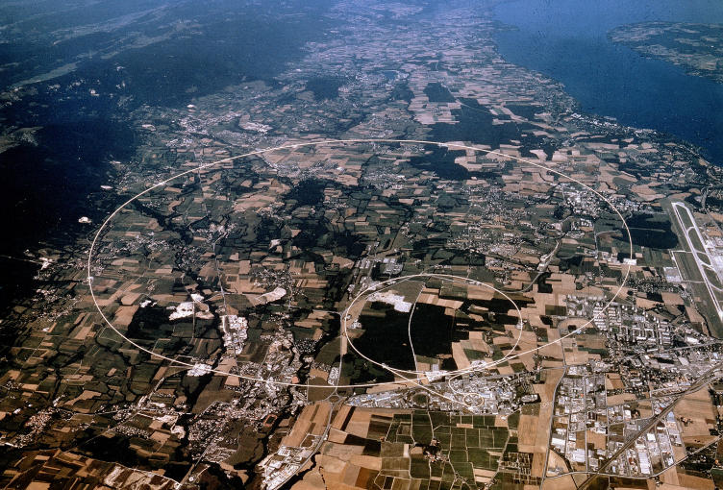
In the Near Future:
High Luminosity LHC
Lake
Michigan
Fermilab site
Chicago

Slide 4
Rate = σ L
With LHC design luminosity of 10³⁴cm⁻²s⁻¹ = 10 nb⁻¹s⁻¹ = 10⁻² pb⁻¹s⁻¹, at 14 TeV:
  σ (top pair production) ~ 700 pb ➔ ~ 7 Hz
  σ (inelastic scattering) ~ 70 mb ➔ ~700 MHz
Actual event rate is limited by bunch crossing
at 20/40MHz, this leads to:
    Multiple interactions per beam crossing (pile up)
    At HL-LHC, expect ~ 140 – 200 pile up.

Slide 5
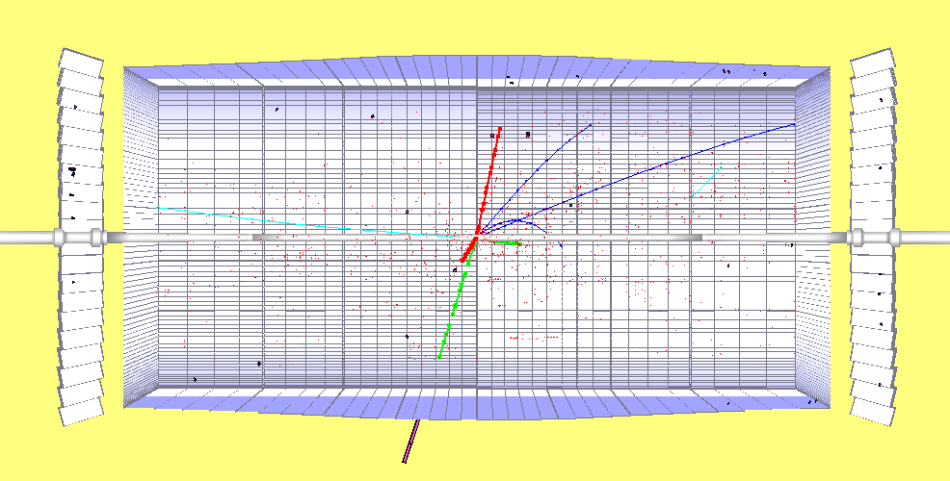
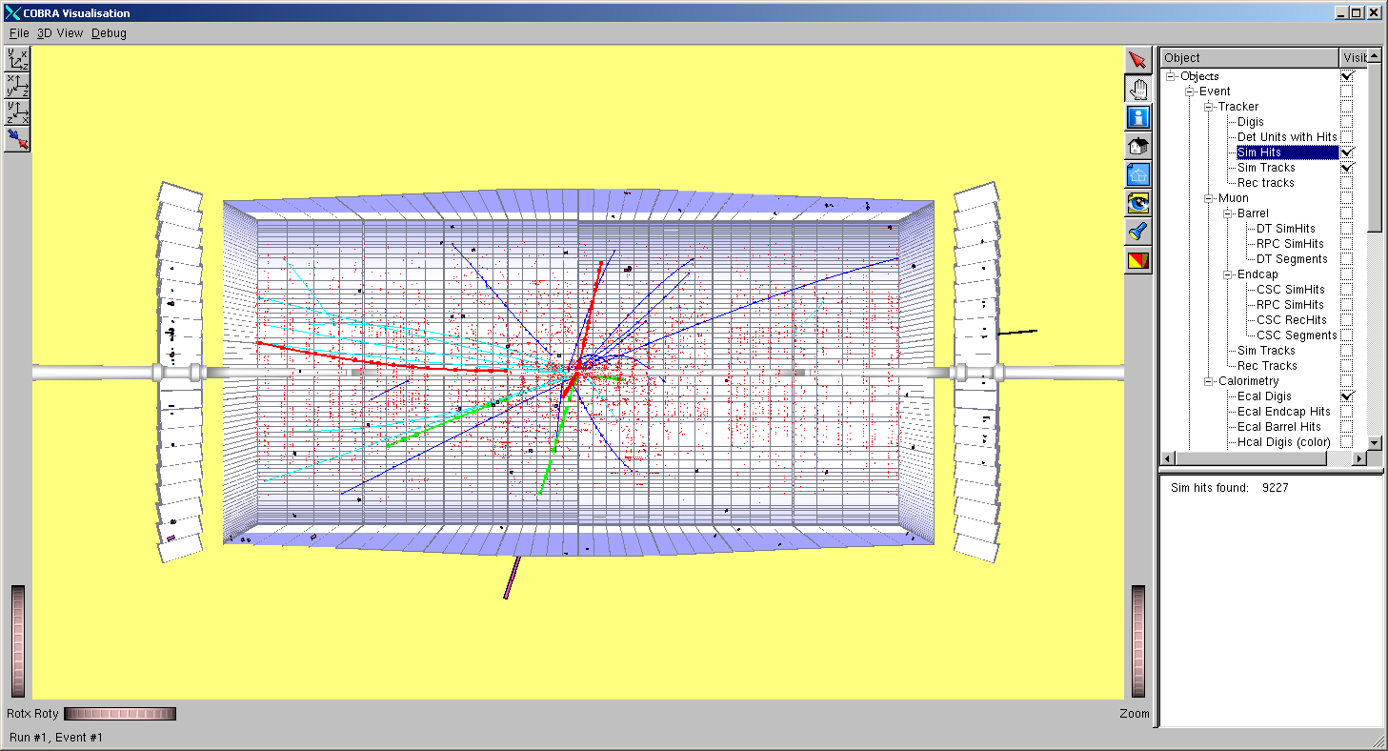
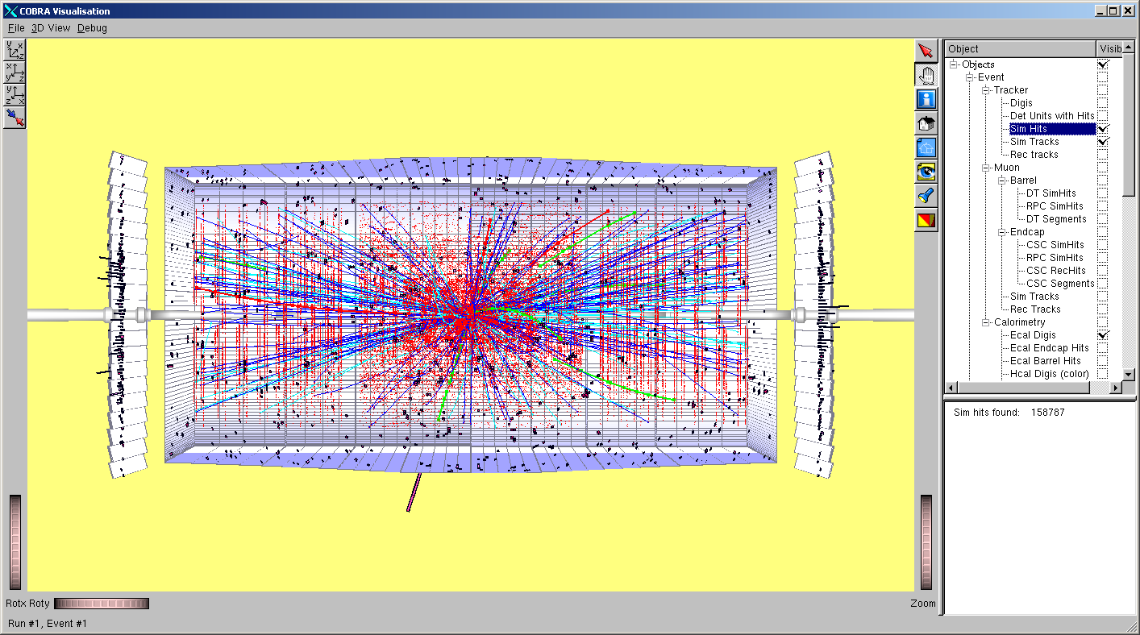
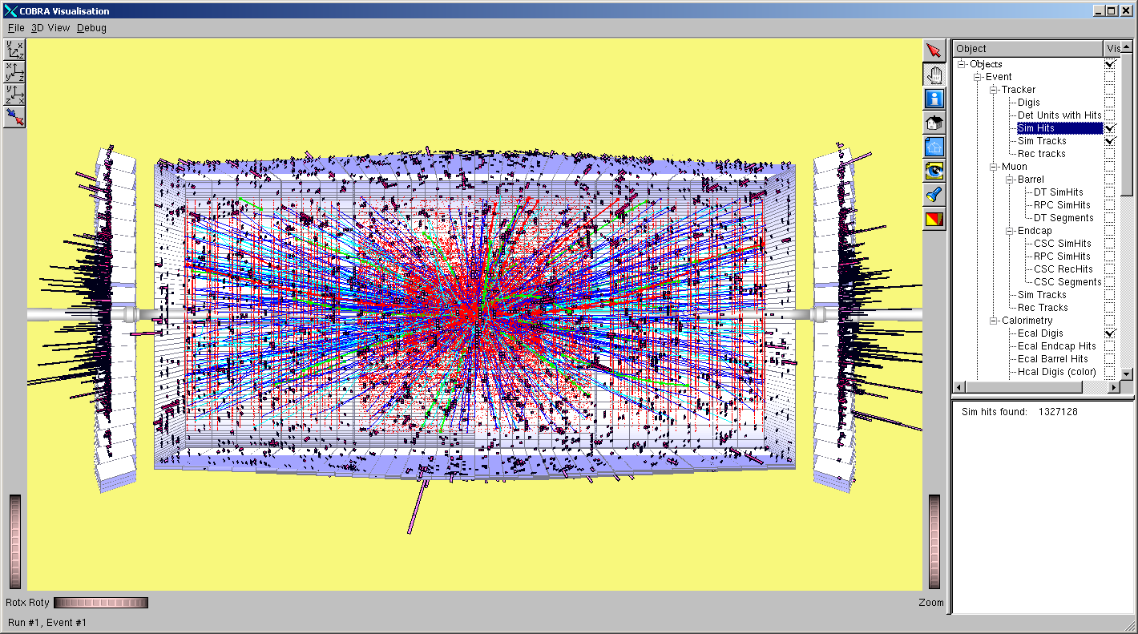
Pile up vs luminosity
H→ZZ → μμee, M_{H}= 300 GeV for different luminosities in CMS
10³² cm⁻²s⁻¹
10³³ cm⁻²s⁻¹
10³⁴ cm⁻²s⁻¹
10³⁵ cm⁻²s⁻¹
HL-LHC

Slide 6
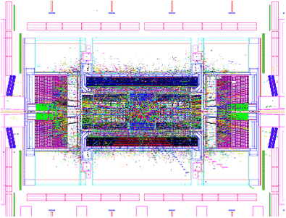
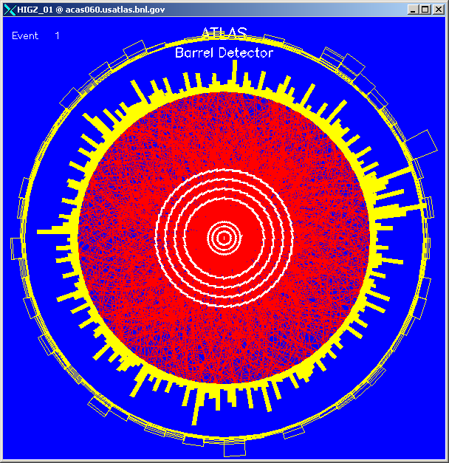
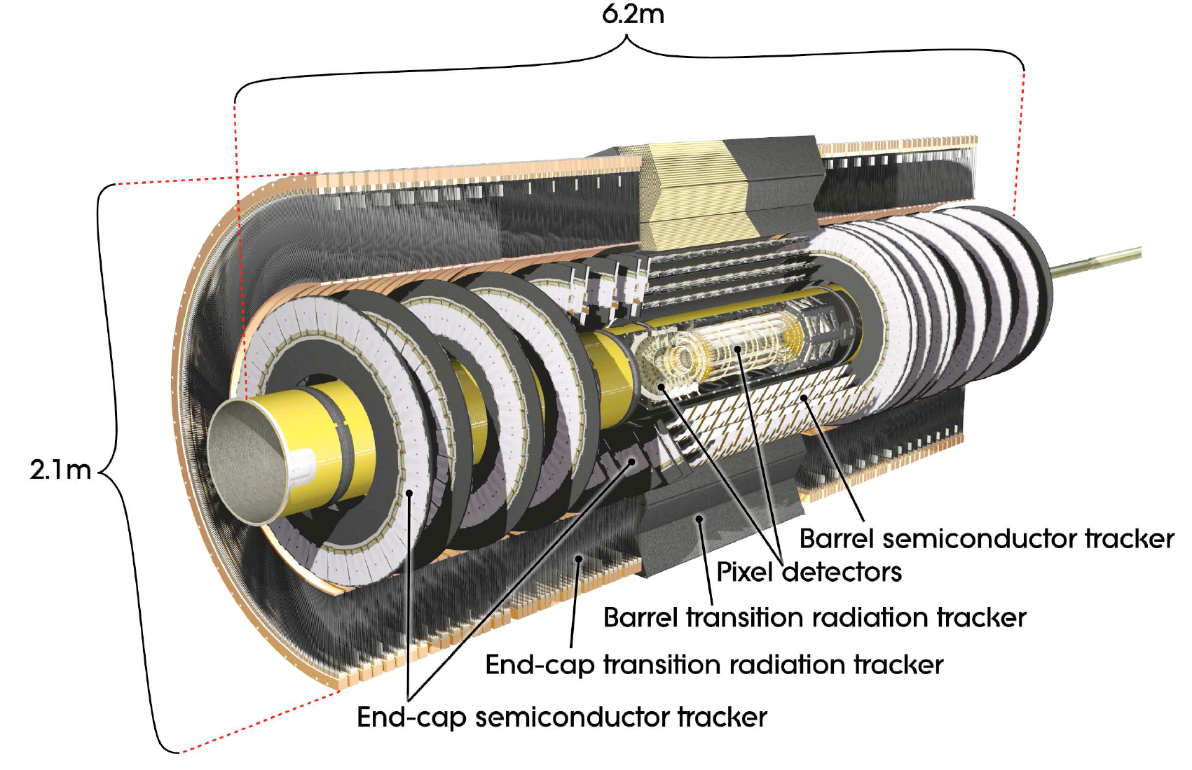
Expected Pile-up at High Lumi LHC in ATLAS at 10³⁵
N_{ch}(|y|≤0.5)

Slide 7
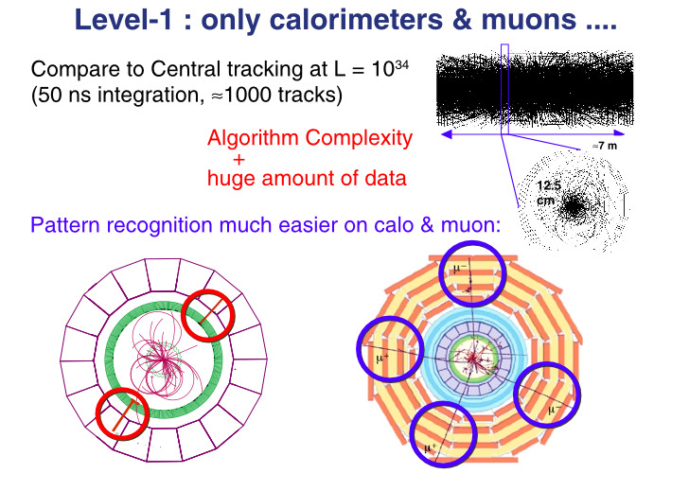
ATLAS and CMS only have calorimeter and muon trigger at Level 1
(no tracking trigger available)
The approach works well only at lower luminosity …
At HL-LHC, will need to move some of HLT algorithms into L1.
Key extra info: silicon based tracking at L1.
Easier said then done.
Complexity handled in software on CPUs
at high level trigger (HLT)

Slide 8
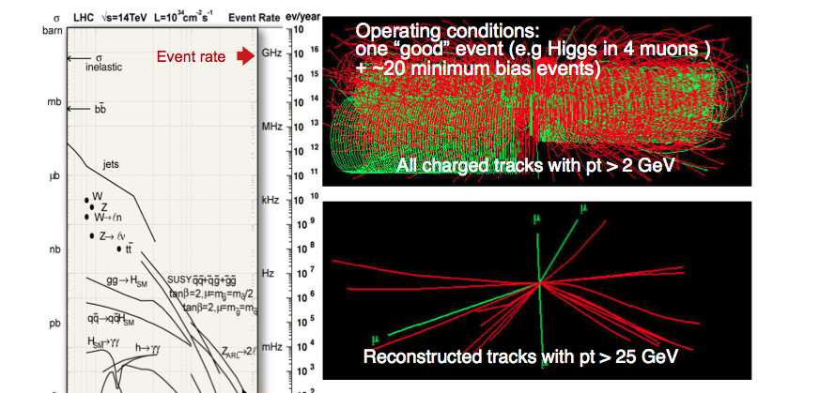
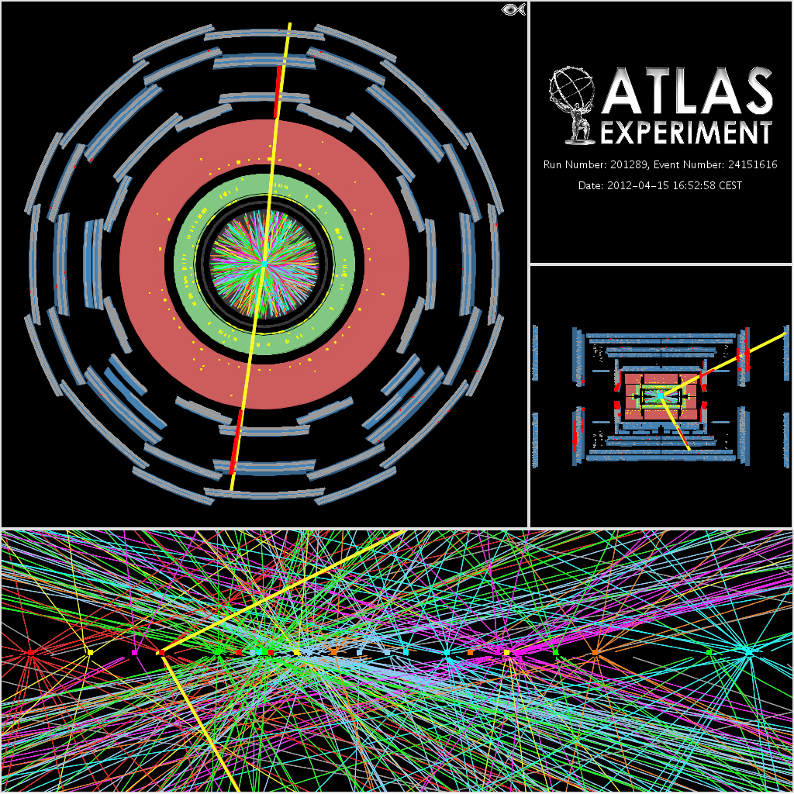
Silicon based tracking trigger at L1 will be crucial for trigger objects reconstruction at
higher luminosity:
Electron
Photon
Muon
Tau
Jets
b-jets
missing ET
….
Essential for establishing
nature of EWSB,
new physics …
Pileup at HL-HC: > ~ 140 (only 20 shown here)
Impact of track reconstruction at L1
real event

Slide 9
CMS L1 Tracking Trigger:
Will need to reconstruct charged particle trajectories “on-the-fly” for every beam crossing (25 ns, or 40 Million beam crossings per second), from an ocean of input data (bandwidth required to transfer up to ~ 50-100Tb/s)
This requires extremely
fast high bandwidth data communication as well as massive pattern recognition power,
with lots known patterns to be compared against the multiple input data streams simultaneously with near zero latency (~ few μs)
This is challenging!
Pileup at HL-HC: > ~ 140 (only 20 shown here)
Impact of track reconstruction at L1

Slide 10
High Performance Computing
→ from US “Report to the President and Congress” by President’s
Council of Advisors on Science and Technology, Dec. 2010 (page 65)
Compute-intensive
  massively parallel computation involving very large number of processing elements;
Communication-intensive
  high-speed transfer of data among processing elements;
Data-intensive
  high-speed manipulation of very large quantities of data
HL-LHC L1 Tracking Trigger is High Performance Computing
(Non-von Neumann approach)
but with very Low Latency and in Real Time
HL-LHC requires the most advanced Real Time processing technology

Slide 11
The LHC case
Frontier physics at LHC in the future:
Go to Higher Energy: needs more aggressive R&D in Magnet
OR
Go to Higher Luminosity: needs aggressive Tracking Trigger R&D
It has become clear that track based trigger capability will be crucial to the frontier physics reach at LHC in the future, as luminosity increases.
The current technology using fiber data transfer, FPGAs, custom chips and modern PCs cannot be scaled in a simple manner to accommodate all the tracking trigger demands.
Significant improvements, or breakthroughs, will be needed. In other words, aggressive R&D efforts will be required.
The rest of talk will show a few examples of the challenges and
➔ How to take advantages of modern (new/emerging) technologies

Slide 12
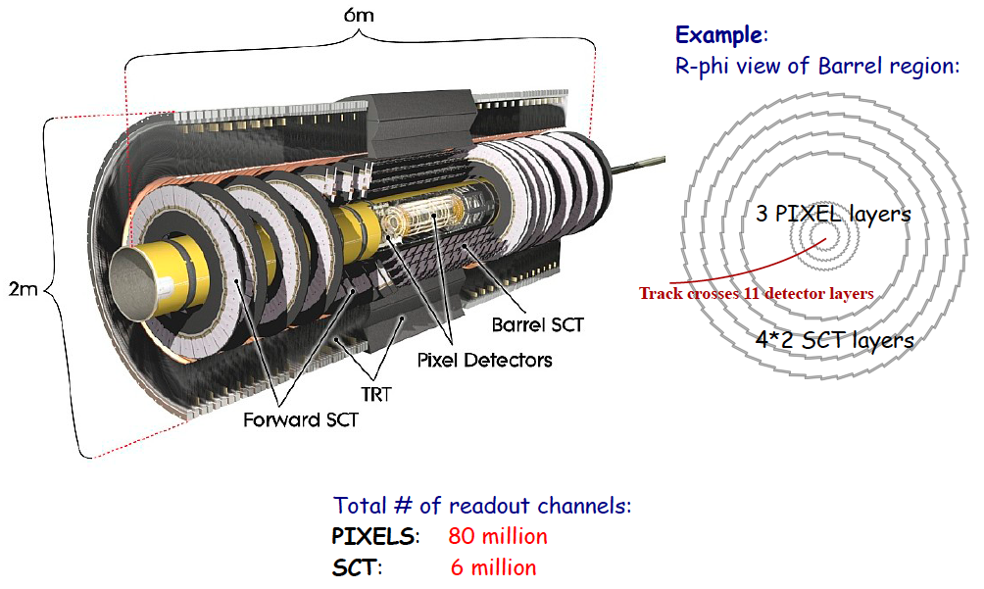
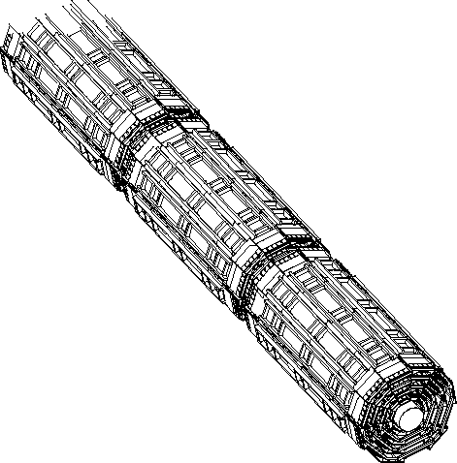
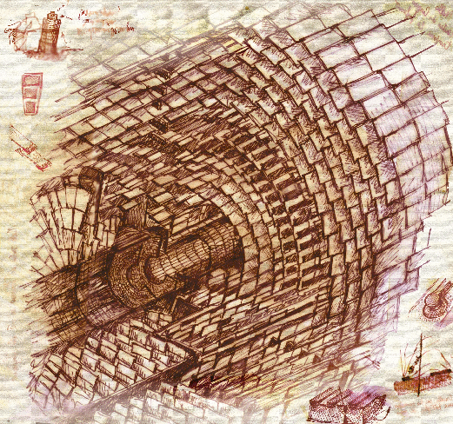
Detector design for triggering
Silicon Based Tracking Trigger at Hadron Colliders
CDF SVXII
Partition detector into
trigger towers/sectors
Beam spot
Pick your favorite method:
Associative Memory (AM) Approach
(proven approach from CDF/SVT)
Hough Transformation
tracklet-based
Adaptive Pattern Recognition
Biology Inspired …
your choice here…
Data transfer
Data formatting
Pattern Recognition
Finer pattern recognition
Track
Fitting
FPGA vs GPU vs CPU
Will use Associative Memory approach
as an example in this talk
HLT
Based on Content Addressable Memory

Slide 13
Content Addressable Memory (CAM)
CAM Operation
  user supplies a data word and it searches its entire memory in a single operation to see if that data word is stored anywhere in it
…..
Pattern 1
Match
Match
Match
Match
Pattern 1
Pattern 3
Pattern 3
Pattern 7
Pattern 7
One incoming pattern/hit at a time
There is no memory of previous matches

Slide 14
The AM approach
Pattern Recognition Associative Memory (for HEP)
  Based on CAM cells to match and majority logic to associate hits in different detector layers to a set of pre-determined hit patterns (simple working unit, yet massively parallel)
  Pattern Recognition finishes right after all hits arrive
  A PR engine naturally handles a given detector region: divide & conquer
Road!
Animation by Jim Hoff (FNAL engineer)
CAMs
Millions of
Patterns
compared
at the same
time
Layer 1
Address 4
Layer 1
Address 4
Match
Match
Match
Match
Match
Match
Match
Match
Match
Match
Match
Match
Match
Match
Match
Match
Match
Layer 2
Address 1
Layer 2
Address 1
Layer 2
Address 4
Layer 2
Address 4
Match
Match
Match
Match
Match
Match
Match
Match
Match
Match
Match
Match
Match
Match
Match
Match
Match
Match
Match
Match
…….
Layer 3
Address 7
Layer 3
Address 7
Layer 3
Address 9
Layer 3
Address 9
Match
Match
Match
Match
Match
Match
Match
Match
Match
Match
Match
Match
Match
Match
Match
Match
Match
Match
Match
Match
Match
Match
Match
Match
Match
Match
Match
Match
Match
Match
Match
Match
Match
Match
Match
Match
Layer 4
Address 4
Layer 4
Address 4
Match
Match
Match
Match
Match
Match
Match
Match
Match
Match
Match
Match
Match
Match
Match
Linearized track fitting can follow each road found (FPGA implementation)

Slide 15
Tracking in 2 steps
Pattern recognition and track fitting done separately and pipelined
Find low resolution track candidates called “roads”.
Roads
Parallel processing,
avoiding the typical power law dependence of
execution time on occupancy and
solving the pattern recognition in times roughly proportional to the number of hits.
Super Bin (SB)
Then fit tracks inside roads.
a linear approximation gives near ideal precision
A very successful approach at CDF for RunII, based on
Associative Memory, which in turn, based on CAM (Content Addressable Memory)

Slide 16
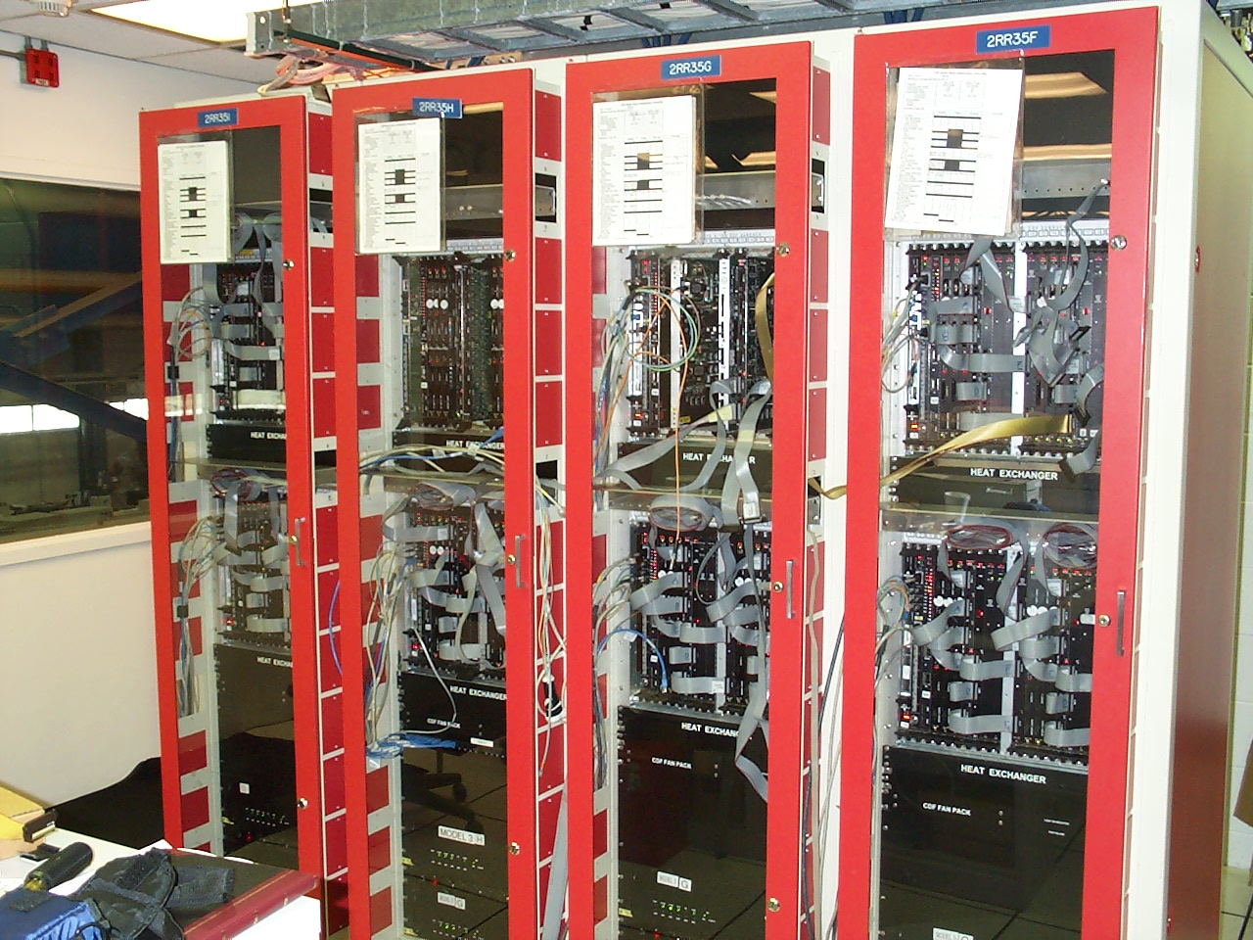
CDF original SVT system had ~400K patterns total …
128 patterns per AMchip -- commissioned around ~2001
(initial concept started in middle 80s!)
0,1
fan-out
fan-in
10,11
2 meters
2,3
4,5
6,7
8,9
Question: can one integrate all these into one chip for HL-LHC?

Slide 17
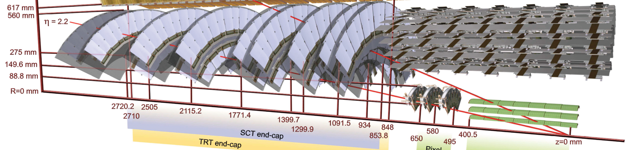
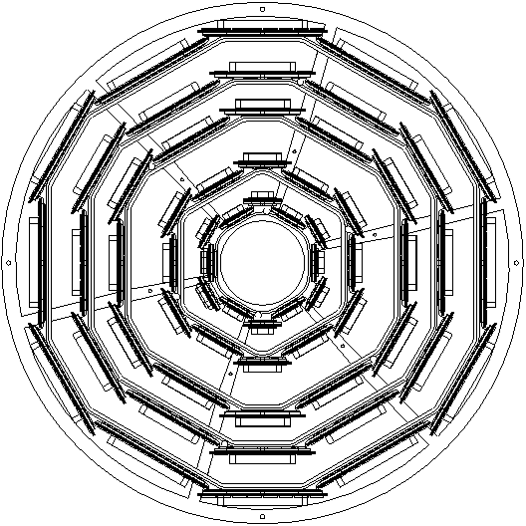
A sense of scale:
Atlas Silicon Tracker vs CDF SVX II
Other relevant aspects:
Collision energy/rate
Pileups/occupancy
Materials
Cabling mapping
…
CDF SVX II
Total # of readout channels:
PIXELS: 80 millions
SCT: 6 millions
Channels used for SVT:
~ 0.2 millions
FTK AM Patterns desired: ~1 Billion patterns 1st used: ~400K

Slide 18
Detector design for triggering
Silicon Based Tracking Trigger at Hadron Colliders
CDF SVXII
Partition detector into
trigger towers/sectors
Beam spot
Pick your favorite method:
Associative Memory (AM) Approach
(proven approach from CDF/SVT)
Hough Transformation
tracklet-based
Adaptive Pattern Recognition
Biology Inspired …
your choice here…
Data transfer
Data formatting
Pattern Recognition
Finer pattern recognition
Track
Fitting
Need massive parallelism and to process in parallel different
regions of the detector for the same crossing (regional multiplexing, L1&L2),
and different crossings coming at different times (time multiplexing, L1)
Requires high bandwidth, low latency, and flexible real time communication,
and a full mesh backplane based hardware platform is a natural fit.
(solution: take advantage of the technology developed from telecommunication industry)
HLT

Slide 19
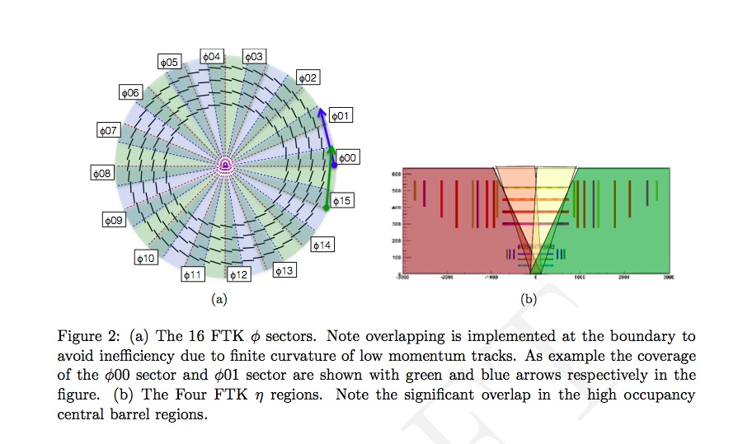
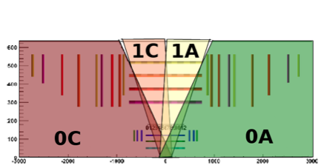
First take a look at: Data formatting challenges for Atlas FTK at L2
The existing silicon tracker was not
designed for tracking trigger …
Input data from all silicon detector modules has to
be formatted into 64 η-φ trigger towers after
reformatting and sharing, ready for downstream
pattern recognition
4 in η

Slide 20
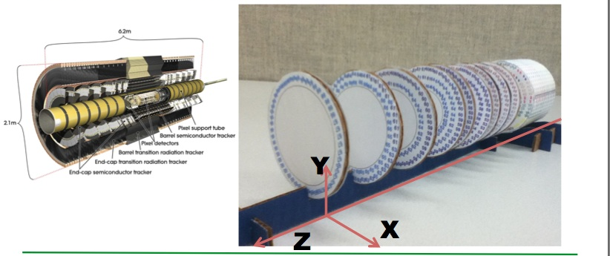
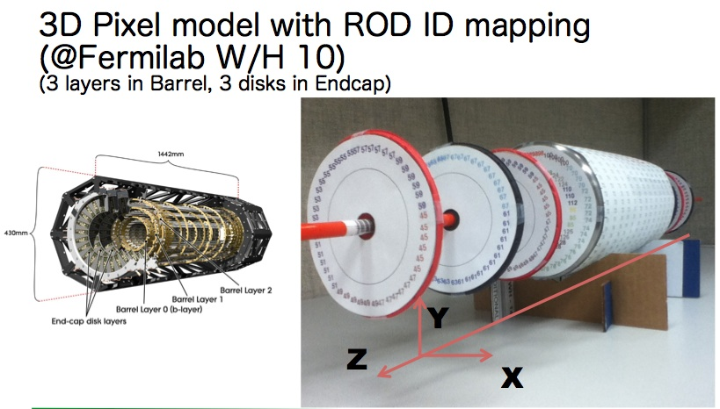
FTK Data Formatting Challenges
3D paper models at Fermilab with detailed ROD ID mapping, to
help understanding the issues
By Yasu Okumura

Slide 21
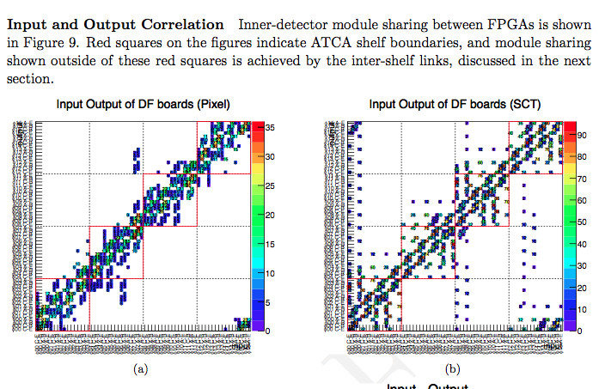
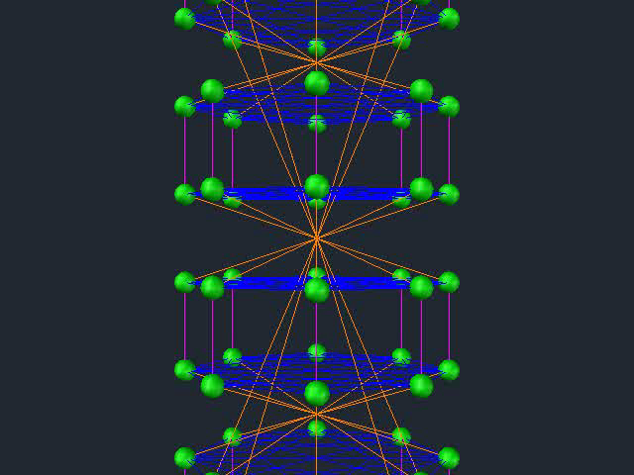
Atlas FTK 64 Trigger Towers (TT) data sharing needs
64 TT
64 TT
Detailed beam data analysis using exact module/ROD cable mapping to trigger towers

Slide 22
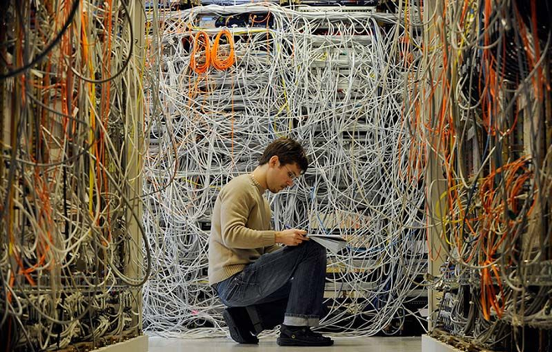
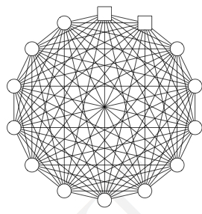
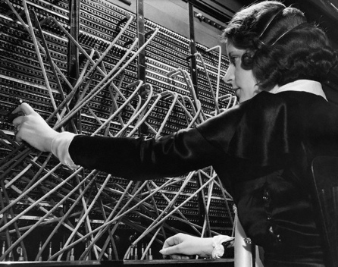
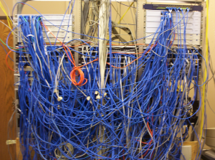
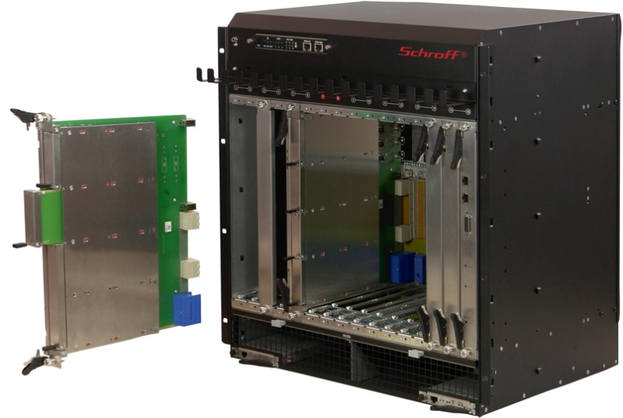
Data sharing/switching techniques
Traditional data sharing
Data sharing with ATCA
  high speed full-mesh backplane
  ~ 40-100 Gbps point to point
Advanced
Telecommunication
Computing
Architecture

Slide 23
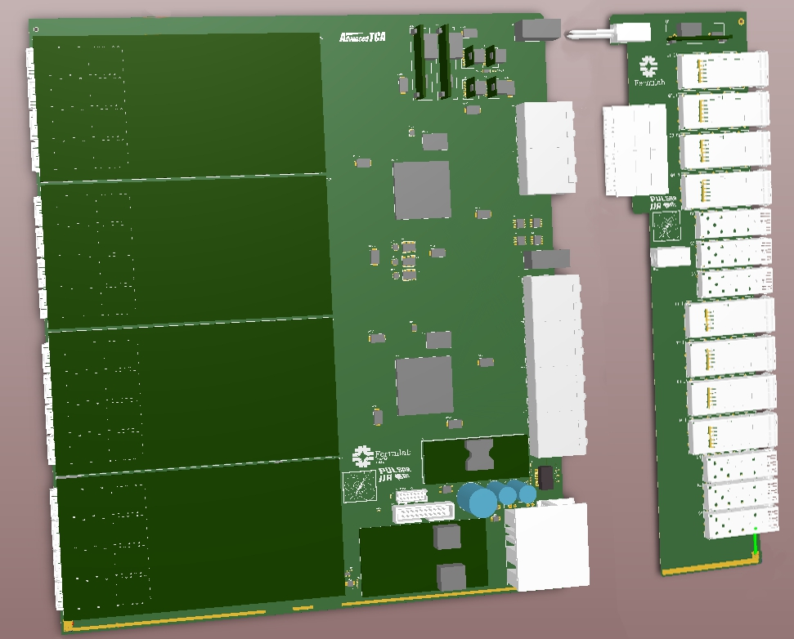
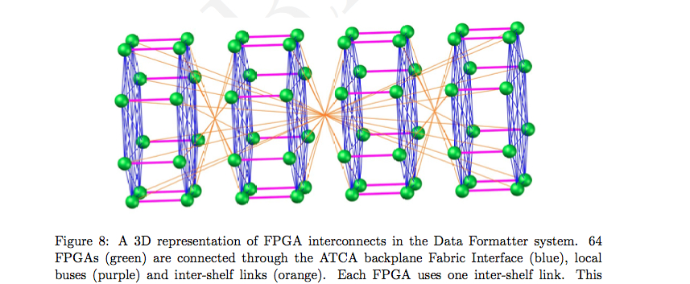
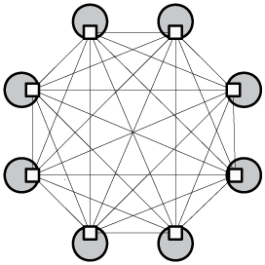
Fermilab (2011)
Data Formatter
Concept:
ATCA-based
How to use ATCA backplane for data sharing
(1 FPGA per trigger tower, 2 trigger towers per board,
32 boards needed over 4 ATCA shelves)
ATCA
Full-mesh
backplane
Only data sharing links shown, not inputs/outputs

Slide 24
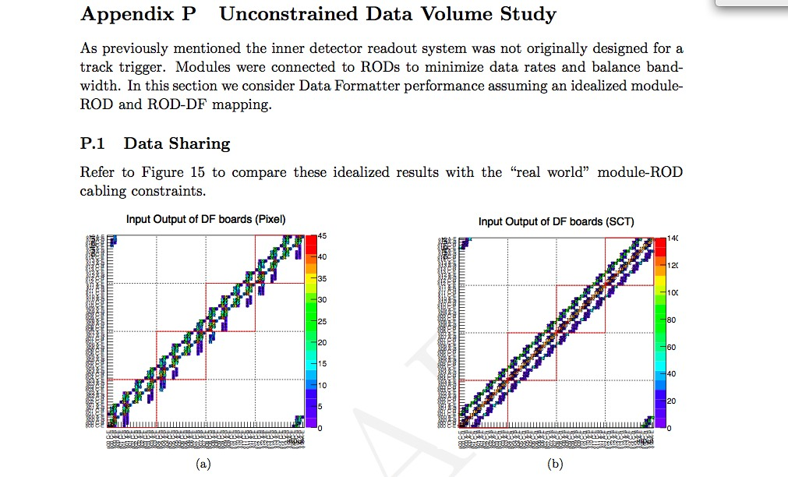
The band would be much cleaner without ROD constraints:
(useful to guide new tracker design for trigger)
From “Data Formatter Design Specification”, Fermilab-TM-2553-E-PPD, page 78.
Available at: http://www-ppd.fnal.gov/EEDOffice-w/Projects/ATCA/

Slide 25
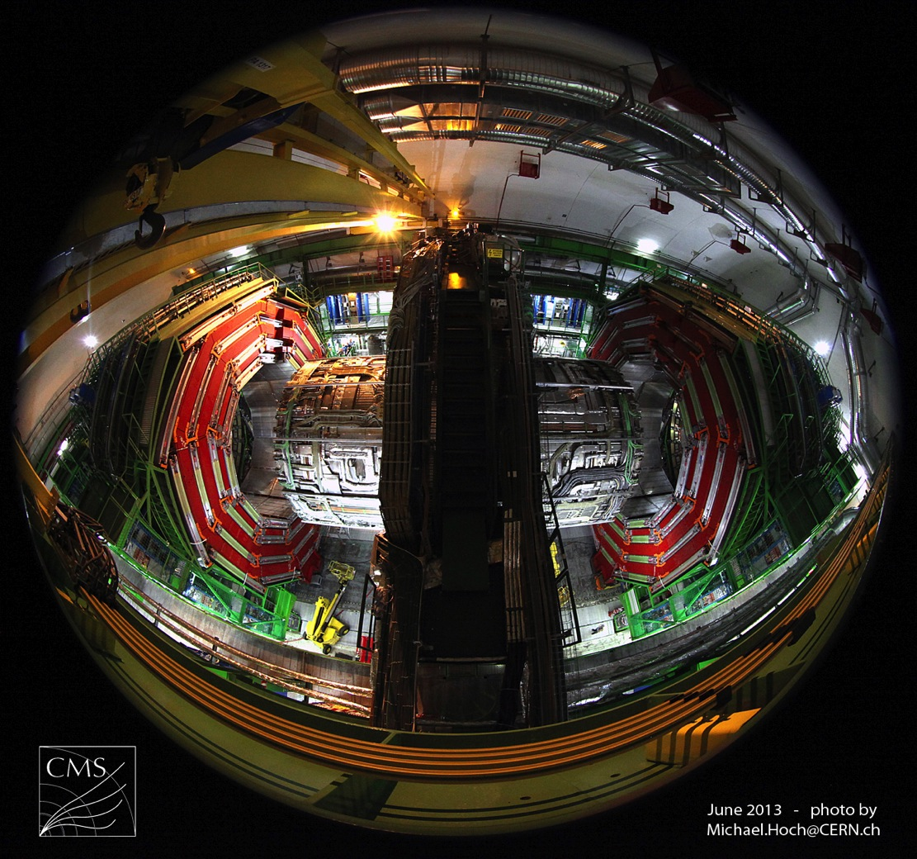
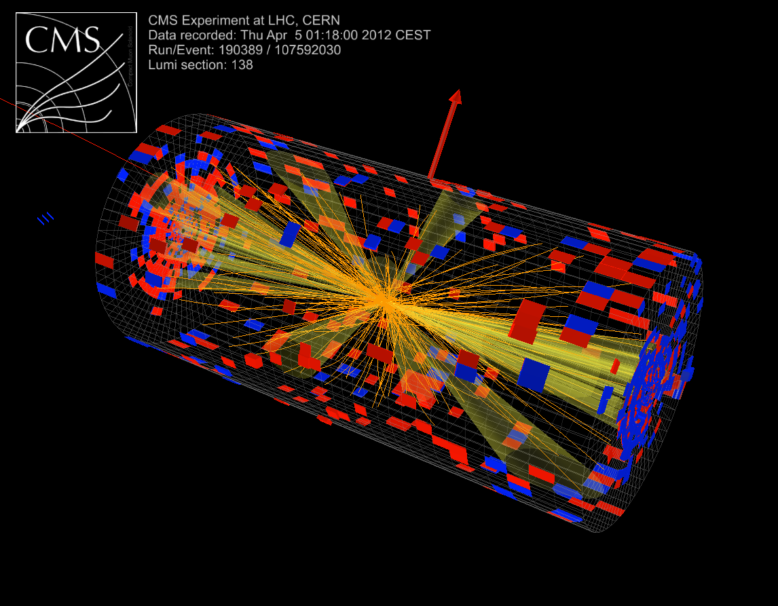
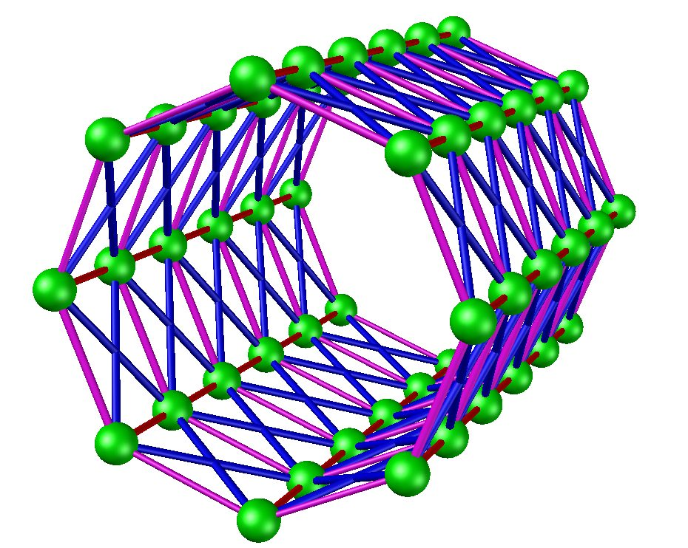
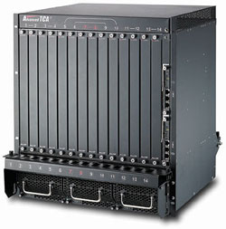
CMS
Tracking Trigger Towers
For simplicity, let’s assume one crate is assigned to one trigger tower
ATCA

Slide 26
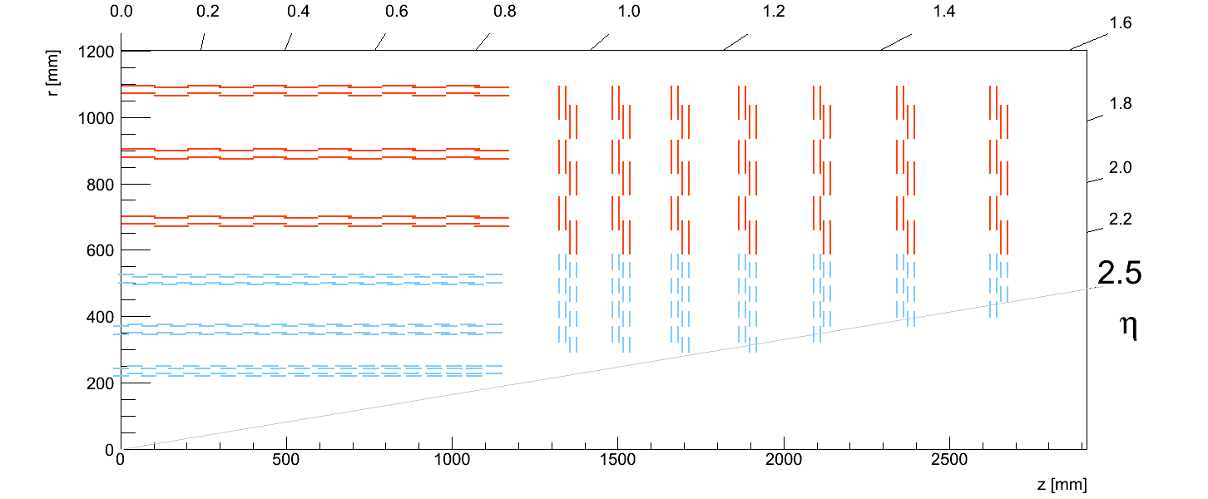
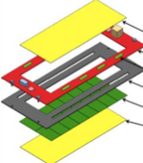
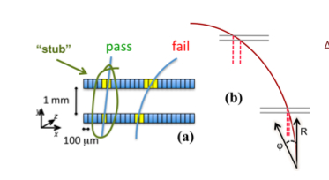
CMS: Module design vs Tracker design vs Trigger processing
Module Design Tracker Design Track Finding
Pt stub finding reduce the data volume by ~ 10-20,
making it possible to transfer the data out for off-detector L1 track finding
~15K modules involved
Back-end
Off-detector
Track Finding
stubs
CMS new tracker design
Working assumptions:
~15K fibers to trigger,
3.2Gbps payload each,
~ 50 Tbps input bandwidth
Block synchronous data
transfer scheme …

Slide 27
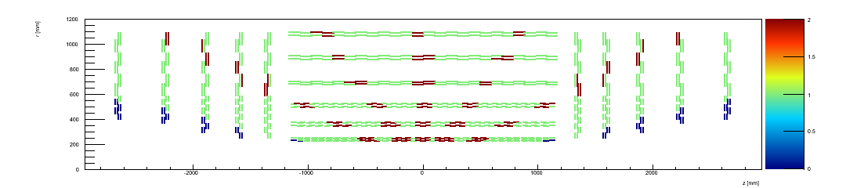
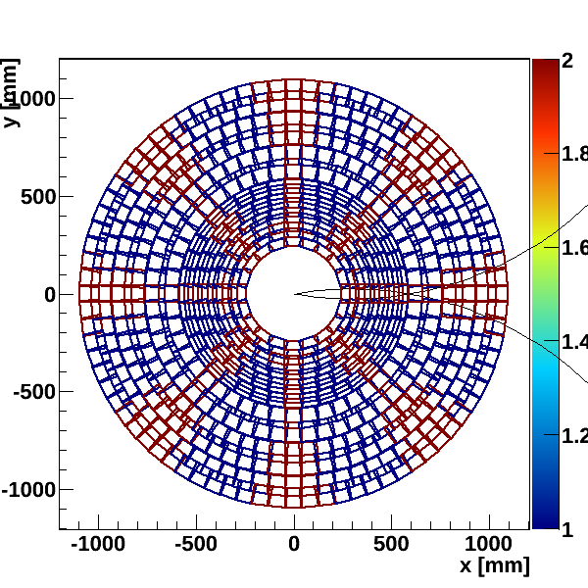
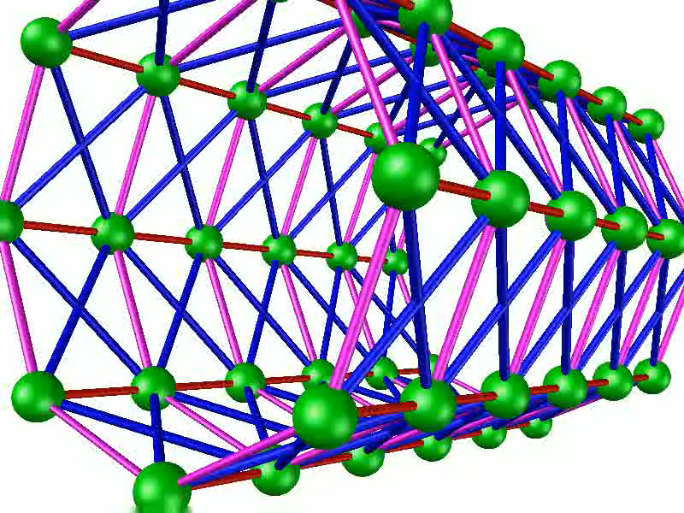
CMS new Tracker Layout and Trigger Tower (6 in eta x 8 in phi)
15K modules
What we learned from FTK data formatting helps to understand CMS L1 case
Animation by Jamieson Olsen (FNAL engineer)

Slide 28
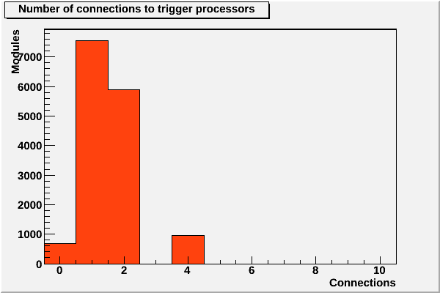
CMS new Tracker Layout and Trigger Tower (6 in eta x 8 in phi)
15K modules
What we learned from FTK data formatting helps to understand CMS L1 case
For a given stub (on a module),
how many trigger towers
need it.

Slide 29
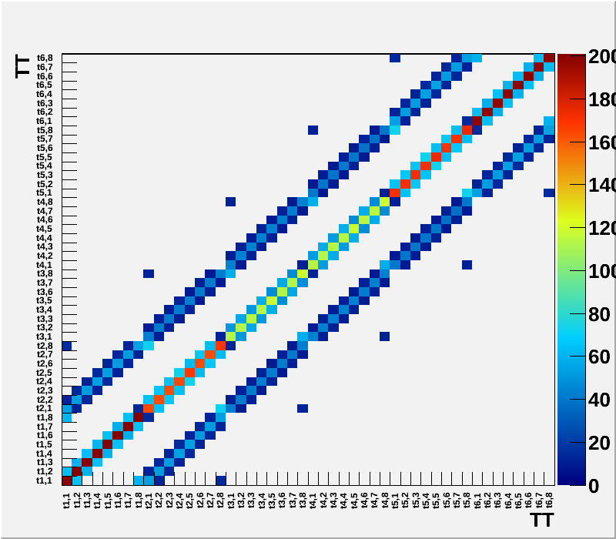
CMS L1 Trigger Tower Data Sharing
In other words,
A Trigger Tower shares at most
with 8 other Trigger Towers
In fact,
Only with immediate neighbors
Phi
Eta
n-1
m-1
n
m-1
n+1
m-1
n-1
m
n
m
n+1
m
n-1
m+1
n
m+1
n+1
m+1

Slide 30
CMS L1 tracking trigger for Phase II:
6 (in eta) x8 (in phi) = 48 Trigger towers &
their interconnections
Data coming from a given trigger
tower may need to be delivered
to multiple trigger towers.
This happens,
when a stub comes from a detector
element is close to the border
Between trigger towers, due to the
finite curvature of charged particles
in the magnetic field and finite size
of the beam luminous region
along the beam axis.

Slide 31
Simple
Trigger Tower
Interconnections.
Each box represents
a trigger tower.
φ
η

Slide 32
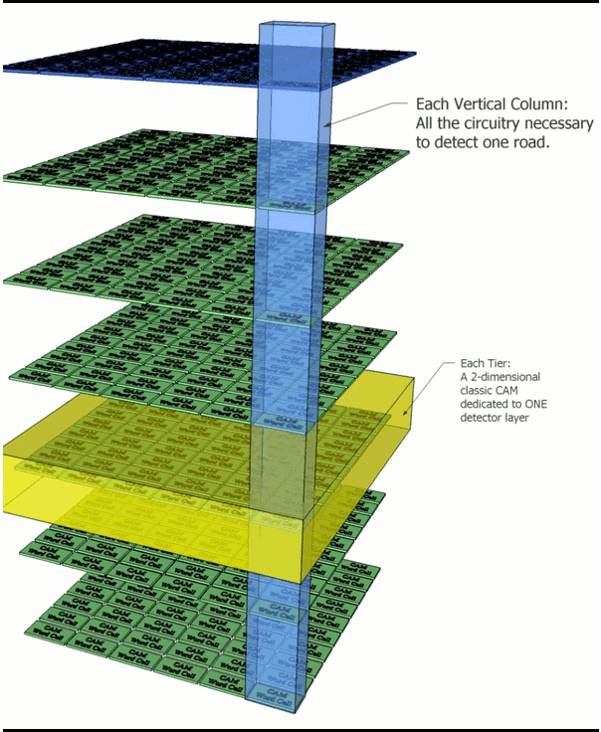
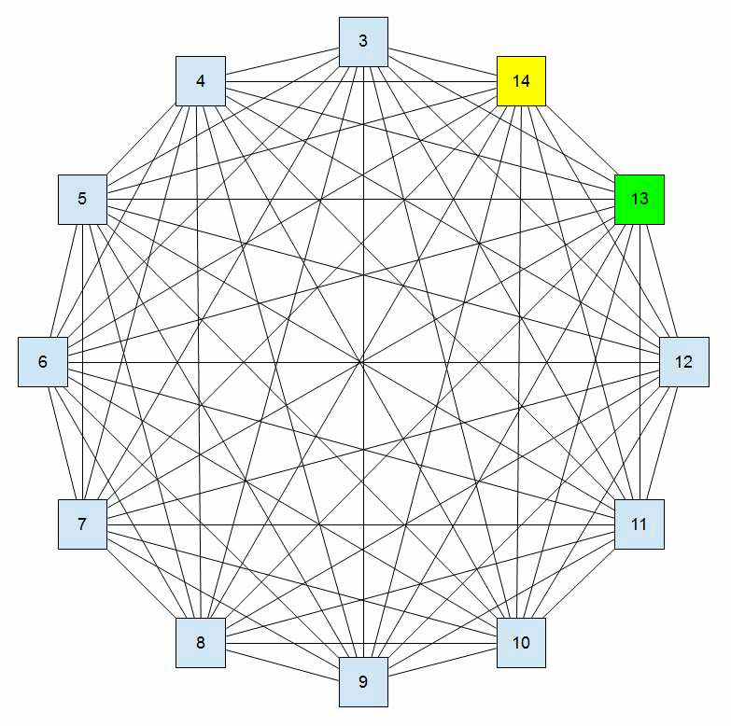


CMS
Tracking Trigger Towers
AM or other track finding approaches implemented on mezzanine (PR engine)
ATCA

Slide 33
More advanced configuration
Ten Processors and the Gateway send the event to the target Processor Blade in a round robin scheme.
To/from eight neighbor
towers
Each processor receives data
directly from upstream on RTM,
and then take turn to handle
different event for each trigger
tower
The full mesh based architecture is highly flexible.
Many performance and bandwidth bottlenecks can be solved/avoided simply by better configurations.
This also makes an early technical demonstration feasible using today’s technology.
The flexible architecture is a good platform for a vertical slice demonstration and beyond.
Note: animated GIF, view as slideshow in PowerPoint

Slide 34

Pattern recognition mezzanine concept
L6
L5
L4
L3
L2
L1
Associative Memory chip
AM2
AM1
in coming
data
Group the patterns and configure the
AM Chips in such a way that
only relevant stubs/hits sent to the
relevant AMchip.

Slide 35


First Pulsar 2a prototypes work well: “plug & play” (summer 2013)
Pulsar 2a
(Kintex 7 FPGAs)
Board delivery later this month
Pulsar 2b
http://www-ppd.fnal.gov/EEDOffice-w/Projects/ATCA/
Pulsar 2b:
  Vertex 7 FPGA (XC7VX690T)
80 GTH lines
General purpose design
I/O ~1 Tbps
How
full-mesh
used for
CMS
L1 TT
case

Slide 36



Pulsar IIa Full crate testing at Fermilab
activate all the GTX at 6.25 Gb/s on 7 boards on full-mesh backplane
Hub board
Achieved maximum speed:
Local bus: 10 Gb/s
RTM : 10 Gb/s
Notes:
HUB board / mezzanine card (LVDS) Pulsar Iib

Slide 37
Comparison: ATLAS L2 FTK and CMS L1 Track Trigger
Existing
Tracker/cabling
not designed for
Tracking Trigger
New
Tracker/Cabling
designed for
Tracking Trigger
for HL-LHC
4 η x 16 φ = 64 trigger towers
6 η x 8 φ = 48 trigger towers
This leads to new Architecture….

Slide 38
Detector design for triggering
Silicon Based Tracking Trigger at Hadron Colliders
CDF SVXII
Partition detector into
trigger towers/sectors
Beam spot
Pick your favorite method:
Associative Memory (AM) Approach
(proven approach from CDF/SVT)
Data transfer
Data formatting
Pattern Recognition
Finer pattern recognition
Track
Fitting
AM system capable of dealing with the
HL-LHC collisions, with the much shorter latency
required by Level 1 triggering, poses significant
technical challenges.
(Emerging 3DIC technology can help)
HLT

Slide 39
3D Technology in 30 seconds
3D technology: the integration of thinned and bonded silicon integrated circuits with vertical interconnects between IC layers
  Vertical interconnects: Through-Silicon-Vias (TSVs)
  Applications: memories, pixel arrays, microprocessors & FPGAs
Performance can be improved by reducing interconnect R/L/C for higher speed and density…
Freedom to divide functionality among tiers to create new designs that are simply not possible in 2D
  Useful when a task can be partitioned into multiple sections that are physically and logically separable, and the interconnects among them are straightforward
  Moore’s law is approaching severe limitations
  3D could be the next scaling engine
  Not just as merely an extension of Moore’s law,
  also provides novel design opportunities

Slide 40

“A New Concept of Vertically Integrated Pattern Recognition Associative Memory”
TIPP 2011 Proceedings http://www.sciencedirect.com/science/article/pii/S1875389212019165
fired road
Pattern recognition for tracking
is naturally a task in 3D
track

Slide 41


The 3D stack is very thin ( < ~ 10 um per tier)
Directly shortens the longest of the driving lines in the
pattern recognition cell (address match lines).
→ reduced power density or increased speed
VIPRAM Design philosophy (2D & 3D): implement the core of AM engine,
leave most of the control and interface logic to FPGA.

Slide 42


Design involved
In 130nm
Control/interface
Majority Logic
Cell design
CAM cell design
25μm
Initial R&D goal:
Proof-of-principle demonstration

Slide 43


3D Architecture intrinsically open/flexible:
“CAM cell” doesn’t have to be CAM
e.g. simple algorithm or even NN …
platform to implement more advanced/fast
pattern recognition algorithm…
possible area for breakthrough
VIPRAM concept
In 3D, with 130 nm, VIRPAM ~160K AM patterns/cm^2
CDF AMchip03: 180 nm, standard cell, 5K AM patterns/chip
Fig. 4 - A 3D PRAM

Slide 44
VIPRAM prototyping work at Fermilab
2D protoVIPRAM
130nm
Global Foundries
5.5mm X 5.5mm
3D building blocks are implemented and tested in 2D:
important design & test methodology
Much of the design work
gone into optimization in 2D
CAM CAM CAM CAM ML
→
25μm
Every single transistor in the core pattern can be tested in 2D

Slide 45


People involved so far from Fermilab:
Engineers: G. Deptuch, J. Hoff, S. Joshi, J. Olsen, M. Trimpl,
Physicists: S. Jindariani, T. Liu, N. Tran
Power/thermal analysis by
W. Xia, P. Gui ( SMU EE)
First protoVIPRAM in 2D
Chip delivered Jan 2014
Initial testing successful,
No problem found.
What’s next:
Performance scan
3D stacking …

Slide 46



74 mm x 149 mm
Test mezzanine card
VIPRAM
test socket
design
actual card
protoVIPRAM chip
SVT in a mezzanine
Future versions
Being used for testing new AM chips at FNAL

Slide 47

SVT in one chip: 2nd phase of VIPRAM project
➔ general purpose pattern recognition
RAMs
New 2.5/3D technology
VIPRM
AM
AM
AM
FPGA
0,1
fan-out
fan-in
10,11
2 meters
2,3
4,5
6,7
8,9
Original SVT system had ~400K patterns total
Aim to reach ~500K patterns per chip for VIPRAM (long term goal)…

Slide 48

animation
After all, the main
purpose of
L1 tracker info
is to confirm
L1 muon
and electron
candidates
Associative memory
||
Confirmation memory
Potentially possible to directly
identify/confirm lepton objects at L1,
many advantages this way…
potential for lepton isolation on chip…
(Food for thoughts)

Slide 49
Associative memory
||
Confirmation memory
One way to reformat data into VIPRAM
L1 Muon tracks
The concept
does not
depend on 3DIC.
Can be done in 2D.
Potentially possible to directly
identify/confirm lepton objects at L1,
many advantages this way…
potential for lepton isolation on chip…
L1 CAL e/γ

Slide 50
Experiment on chip
Lepton isolation in a chip?
High Pt lepton
(Food for thoughts)
High Pt lepton takes much less patterns
Isolation veto doesn’t require high eff for low Pt tracks →much less patterns
Number of fired roads MUCH less (track fitting stage MUCH simpler/faster)

Slide 51


What if one could implement
much more patterns with 3D?
Triggering Taus at L1?
Need detailed studies
tau
(Food for thoughts)
Experiment on chip?

Slide 52


Slide 53


Slide 54


Slide 55



2005

Slide 56

Tracking Trigger
Vertical Slice System Demonstration
over next few years
The tracker design cannot be finalized
without demonstration of tracking trigger
one trigger tower
With the goals:
  Performance study (latency, efficiency etc)
  Identify issues/bottlenecks
  Guide future R&D, find solutions
  A common platform to explore
  new ideas/algorithm/approaches
Data Source stage

Slide 57
with some examples
Detector design for triggering
HL-LHC Tracking Trigger Challenges
CDF SVXII
Beam spot
Data transfer
Data formatting
Telecommunication technology
Pattern Recognition
Emerging 3DIC
Technology promising
Tracking Trigger capability will be crucial to
the frontier physics reach at HL-LHC.
Significant improvements, or breakthroughs,
will be needed.
Aggressive R&D on going, still much challenges ahead!
Extremely fast data communication & massive pattern recognition
Technical demonstration needs to be done in a few years
Extensive simulation work for physics cases to guide the R&D
USCMS: FNAL/Northwestern/Cornell/Purdue/Florida/…(LPC)
Track
Fitting
Modern FPGAs
HLT

Slide 58
Backup slides
3DIC intro
others

Slide 59
Some Basic TSV Information
TSV ranges in size from 1-100 um in diameter and are filled or plated with a conductive material.
TSVs are primarily used as an electrical connection or a heat conductor.
A TSV is a critical part of the 3D integration process
TSVs are used in
  3D wafer level packages
  3D silicon interposers
  3D integrated circuits
“3D packaged” parts that do not use TSVs are NOT considered 3D integration

Slide 60


Slide 61


Anatomy of a PRAM
(Pattern Recognition Associative Memory)
address
match
latch
Majority Logic
CAM Cells
(only 6 out 15 bits shown)
Trace Length -> Capacitance -> Power Consumption or Reduced Speed
More detector layers, or more bits involved, design more spread out in 2D
Challenges in 2D

Slide 62

Commericial HUB boards
One simple configuration
as an example
4 Pattern
Recognition
Boards
ATCA
Full-Mesh
Backplane
8 Data
Input
Boards
What’s inside
one trigger
tower/crate
Fibers from upstream
40Gbps

Slide 63
Commericial HUB boards
One simple configuration
as an example
4 Pattern
Recognition
Boards (PRB)
8 Data
Input
Boards
Fibers from upstream

Slide 64
Commericial HUB boards
One simple configuration
as an example
4 Pattern
Recognition
Boards
8 Data
Input
boards
Fibers from upstream

Slide 65

Data Input board Close-up
RTM:
Fibers
from upstream
(FPGA)
Rough estimate:
Assume 200 stubs / trigger tower, ~32 bits per stub (overestimated), the traffic from DIB to each PRB is about 8Gbps with zero suppression
Fabric backplane

Slide 66
Pattern Recognition Board (PRB) data flow
Neighbor
data sharing
to/from
another
Trigger Tower
AM based

Slide 67

Pattern Recognition Mezzanine (PRM)
Relaxed Performance Requirements (in the case of 10 PRBs with ~40 PRMs):
40MHz input handled by 40 PRM mezzanines in round robin, each handles
~1MHz event input rate
Event Processing >= 1MHz (out of 40MHz)
Input BW >= 16Gbps
In the case of AM approach:
~10 AM chips / PRM
~200k patterns / AMchip
~ 2M patterns / tower
(2M x 48 towers ~ 100M patterns)
System size shrinks with better
AMchip performance:
If 2X more AM pattern density,
or 2X higher AM speed,
2 x less system size
(48 crates → 24 crates)
The relaxed performance requirement would make
early technical demonstration easier for different
track finding approaches.

